Slide 1
The Frog Cell Cycle
Defining the Reactions
and
Differential Equations
Nancy Griffeth
January 13, 2014
Funding for this workshop was provided by the program “Computational Modeling and Analysis of Complex Systems,” an NSF Expedition in Computing (Award Number 0926200).

Slide 2
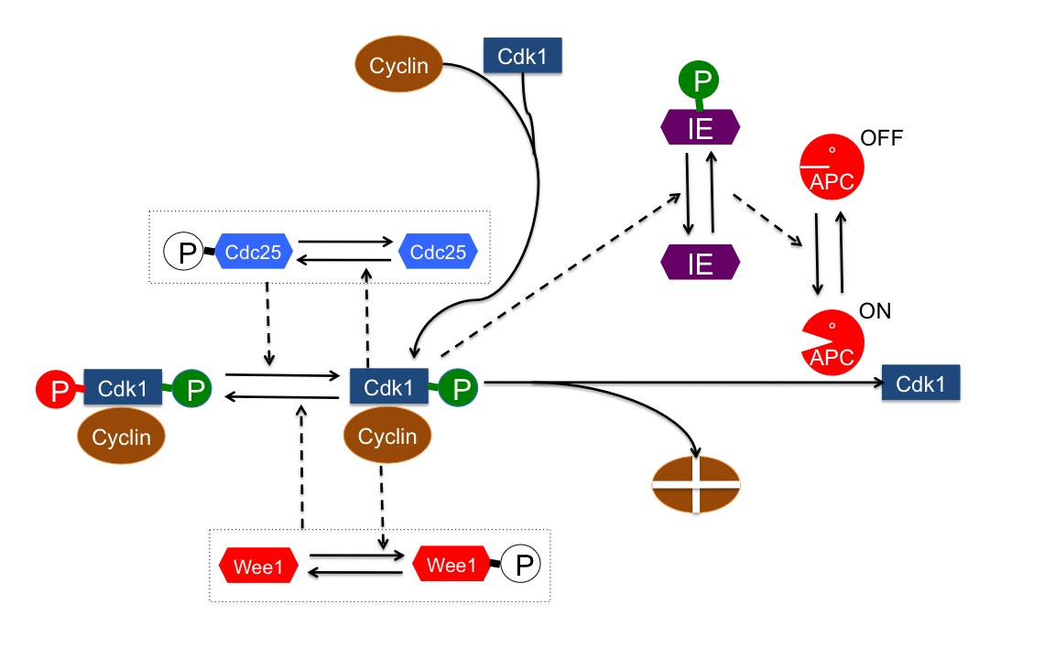
Developing the model
1. Accumulating MPF
2. Degrading MPF
Key:
Solid lines are reactions
Dotted lines represent catalytic action
Notes:
I will explain the diagram piece by piece, and develop rules for each piece as we go.
First we will develop the rules for accumulating cyclin, then for degrading cyclin

Slide 3
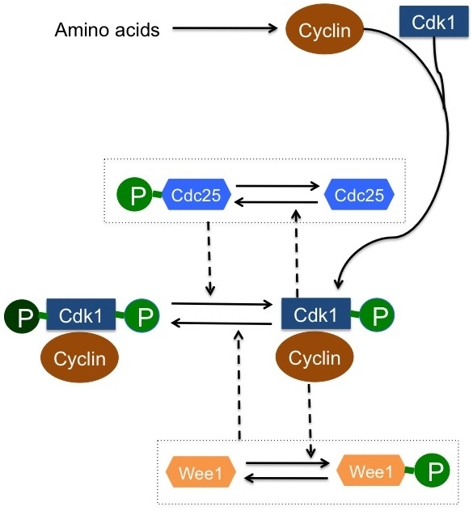
The Model
From Amino Acids to MPF
Accumulating MPF
Notes:
Accumulating cyclin – two pieces: first, formation of the cyclin-cdk1 complex; then, a complex set of feedbacks lock the complex into its singly-phosphorylated form.
We take the second one (Accumulating MPF) first

Slide 4
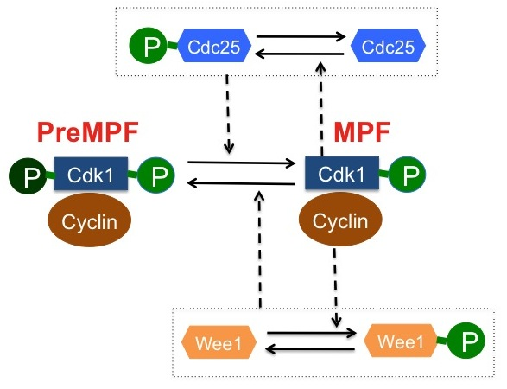
Developing the Rules
Accumulating MPF
PreMPF: the doubly-phosphorylated Cyclin-cdk1 complex
MPF: the singly-phosphorylated Cyclin-cdk1 complex
Notes:
Starting in the middle (the approach is from the middle out):
First PreMPF accumulates, because at first the environment favors the MPF->PreMPF reaction over the PreMPF->MPF reaction. Then as MPF influences the concentrations of Cdc25 and Wee 1, the favored reaction changes and PreMPF -> MPF dominates.
The next few slides will indicate why.

Slide 5
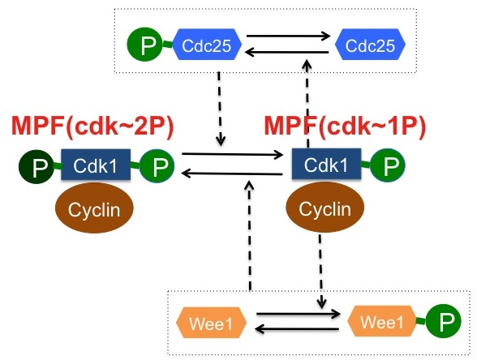
Developing the Rules
Accumulating MPF
Patterns used in rules:
  MPF is represented
  MPF(cyclin,cdk~1P)
  PreMPF is represented
  MPF(cyclin,cdk~2P)
Notes:
For brevity, I left the “cyclin” component out of the MPF pattern in the diagram

Slide 6
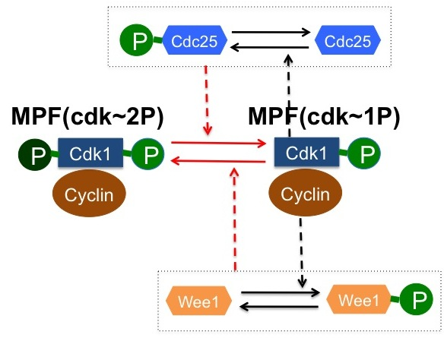
Developing the Rules
Accumulating MPF
MPF <-> PreMPF Diagram
MPF <-> PreMPF rules
MPF -> PreMPF
The kinase Wee1 adds a phosphate group to MPF
MPF(cyclin,cdk~1P)+Wee1 -> MPF(cyclin,cdk~2P)+Wee1
PreMPF ->MPF
The phosphatase Cdc25 removes a phosphate group from PreMPF:
MPF(cyclin,cdk~2P)+Cdc25 -> MPF(cyclin,cdk~1P)+Cdc25
Notes:
MPF is catalyzed by Wee1 to become PreMPF (ie, it’s phosphorylated on a second tyrosine residue)
PreMPF is catalyzed by Cdc25 to become MPF (ie, it’s dephosphorylated)

Slide 7
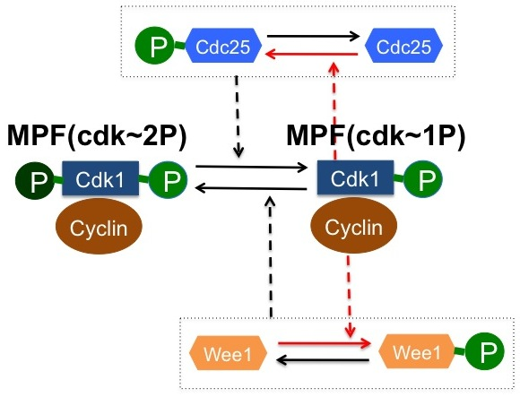
Developing the Rules
Accumulating MPF
Phosphorylating Cdc25
MPF acts as a kinase to add a phosphate group to Cdc25:
MPF(cyclin,cdk~1P)+Cdc25(c~U) -> MPF(cyclin,cdk~1P)+Cdc25(c~P)
Phosphorylating Wee1
MPF acts as a kinase to add a phosphate group to Wee1:
MPF(cyclin,cdk~1P)+Wee1(c~U) -> MPF(cyclin,cdk~1P)+Wee1(c~P)
For these rules, we add a component “c” with states “U” and “P” to Cdc25 and to Wee1: Cdc25(c~P~U), Wee1(c~P~U)

Slide 8
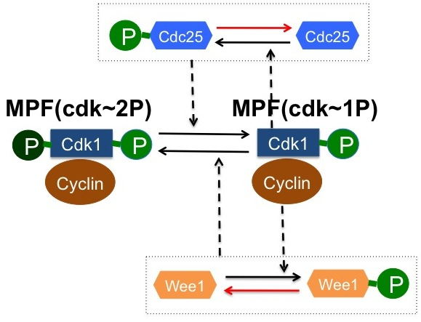
Developing the Rules
Accumulating MPF
Dephosphorylating Wee1 and Cdc
An (unspecified) phosphatase removes phosphate groups from Wee1 and Cdc25:
Cdc25(c~P)+PPase() ->
Cdc25(c~U)+PPase()
Wee1(c~P)+PPase() ->
Wee1(c~U)+PPase()
The phosphorylation states of Wee1 and Cdc25 change the reaction rates for MPF and PreMPF and hence they also change the steady states. These are the feedback loops.
Notes:
Phosphorylating Cdc25 increases the reaction rate for converting PreMPF to MPF
Phosphorylating Wee1 decreases the reaction rate for converting MPF to PreMPF
Initially, the reaction rates favor the formation of PreMPF (with neither Wee1 nor Cdc25 phosphorylated) but when both are phosphorylated, the reaction rates favor the formation of MPF.

Slide 9
We will track the amount of active cyclin
To do this, we use a component “deg”:
Cyclin(deg~n~y)
to indicate whether or not the cyclin has been degraded
The states indicate that the cyclin is degraded (deg~y) or not (deg~n)

Slide 10
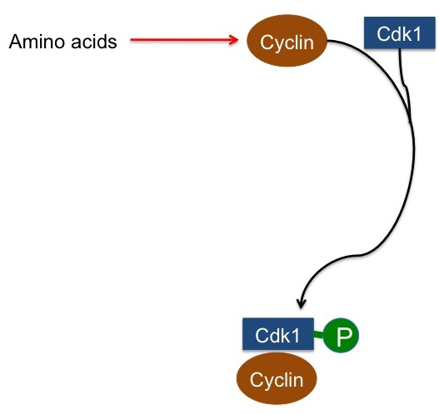
Developing the Rules
Accumulating MPF
Cyclin is constructed from amino acids, treated here as always available (defying mass conservation!):
AA() -> AA()+Cyclin(deg~n)
Notes:
Initially the Cyclin is active (not degraded)

Slide 11
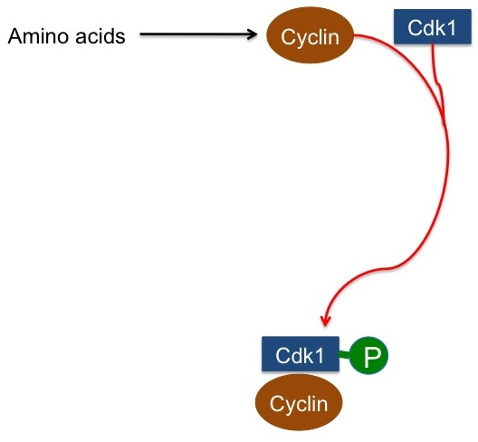
Developing the Rules
Accumulating MPF
Cyclin and Cdk1 combine to form MPF:
Cyclin(deg~n)+Cdk() ->
MPF(cyclin,cdk~1P)

Slide 12
The Rules So Far
# Cyclin is constructed from amino acids
AA() -> AA()+Cyclin(deg~n)
# Cyclin and Cdk1 combine to form MPF
Cyclin(deg~n)+Cdk() -> MPF(cyclin,cdk~1P)
# Wee1 phosphorylates MPF, turning it into PreMPF
MPF(cyclin,cdk~1P)+Wee1 -> MPF(cyclin,cdk~2P)+Wee1
# Cdc25 dephosphorylates PreMPF, turning it into MPF
MPF(cyclin,cdk~2P)+Cdc25 -> MPF(cyclin,cdk~1P)+Cdc25
# MPF phosphorylates Cdc25 and a phosphatase dephosphorylates it
Cdc25(c~U)+MPF(cyclin,cdk~1P) -> Cdc25(c~P)+MPF(cyclin,cdk~1P)
Cdc25(c~P)+PPase() -> Cdc25(c~U)+PPase()
# MPF phosphorylates Wee1 and a phosphatase dephosphorylates it
Wee1(c~U)+MPF(cyclin,cdk~1P) -> Wee1(c~P)+MPF(cyclin,cdk~1P)
Wee1(c~P)+PPase()->Wee1(c~U)+PPase()
Notes:
This is what we’ve done so far.

Slide 13
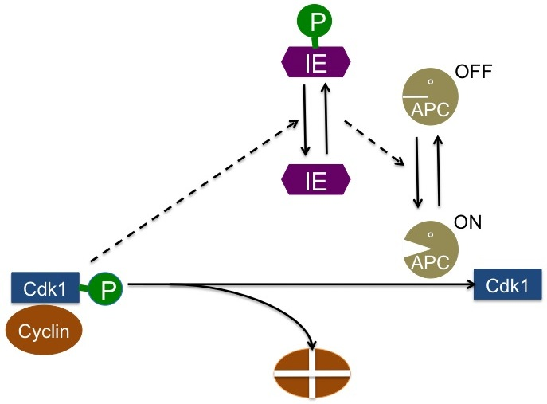
Developing the Rules
Degrading MPF
Notes:
MPF phosphorylates an enzyme in the APC, which results in the activation of APC. Active APC degrades MPF back into Cdk1 and the amino acids that are used to build cyclin.

Slide 14
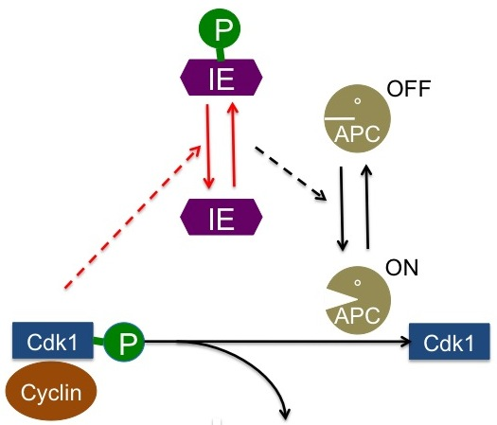
Developing the Rules
Degrading MPF
MPF phosphorylates an enzyme:
IE(c~U)+MPF(cyclin,cdk~1P) ->
IE(c~P)+MPF(cyclin,cdk~1P)
A phosphatase dephosphorylates
the enzyme:
IE(c~P)+PPase() ->
IE(c~U)+PPase()

Slide 15
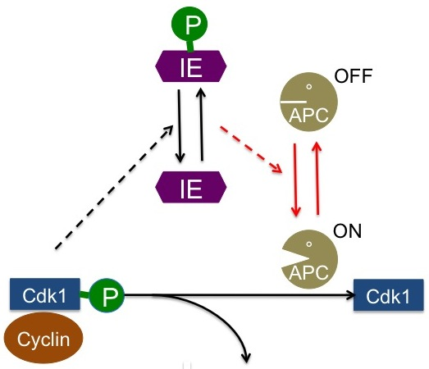
Developing the Rules
Degrading MPF
The enzyme activates APC:
APC(c~OFF)+IE(c~P) ->
APC(c~ON)+IE(c~P)
The phosphatase deactivates APC:
APC(c~ON)+PPase() ->
APC(c~OFF)+PPase()

Slide 16
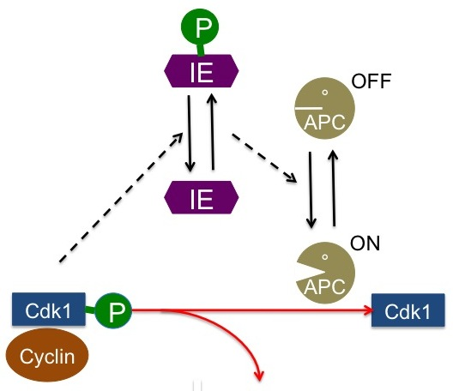
Developing the Rules
Degrading MPF
APC degrades all forms of cyclin:
Cyclin(deg~n)+APC(c~ON) ->
Cyclin(deg~y)+APC(c~ON)
MPF(cyclin,cdk~*)+APC(c~ON) ->
Cyclin(deg~y)+Cdk1+APC(c~ON)

Slide 17
The Rest of the Rules
# MPF phosphorylates an enzyme, phosphatase dephosphorylates it
IE(c~U)+MPF(cyclin,cdk~1P) -> IE(c~P)+MPF(cyclin,cdk~1P)
IE(c~P)+PPase() -> IE(c~U)+PPase()
# The enzyme activates APC, the phosphatase deactivates APC
APC(c~OFF)+IE(c~P) -> APC(c~ON)+IE(c~P)
APC(c~ON)+PPase() -> APC(c~OFF)+PPase()
# Active APC degrades all forms of cyclin
Cyclin(deg~n)+APC(c~ON) -> Cyclin(deg~y)+APC(c~ON)
MPF(cyclin,cdk~*)+APC(c~ON) -> Cyclin(deg~y)+APC(c~ON)
Notes:
This is what we’ve done so far.

Slide 18
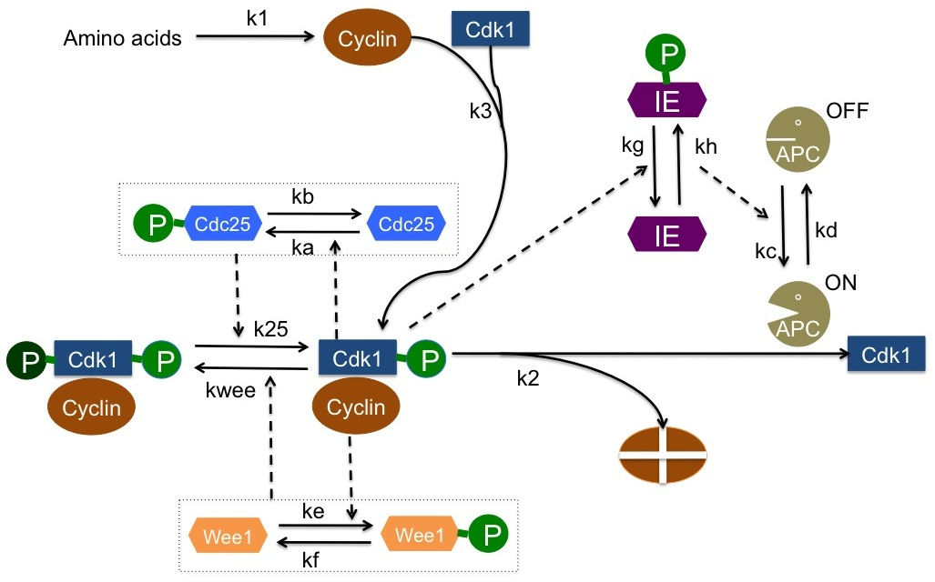
Determining the reaction rates
Notes:
Reaction rates are given on the diagram, but what do they mean?
K1 and k3 are straightforward mass action kinetics
K2 has two values, depending on whether APC is on or off – we define two rules to deal with this
Ka, kb, kc, kd, ke, kf, kg, and kh are all catalytic reaction rates – we use the Sat function to compute the Michaelis-Menten rate for these reactions
K25 and kwee are rates for catalytic reactions, but there are two rates depending on the phosphorylation states of Cdc25 and Wee 1. We will use two rules each and an auxiliary computation.

Slide 19
Cyclin
Cdk1
P
APC
OFF
IE
P
Cdc25
Cdc25
IE
ON
APC
P
Cdk1
P
Cdk1
P
Cdk1
Cyclin
Cyclin
Wee1
Wee1
P

Slide 20
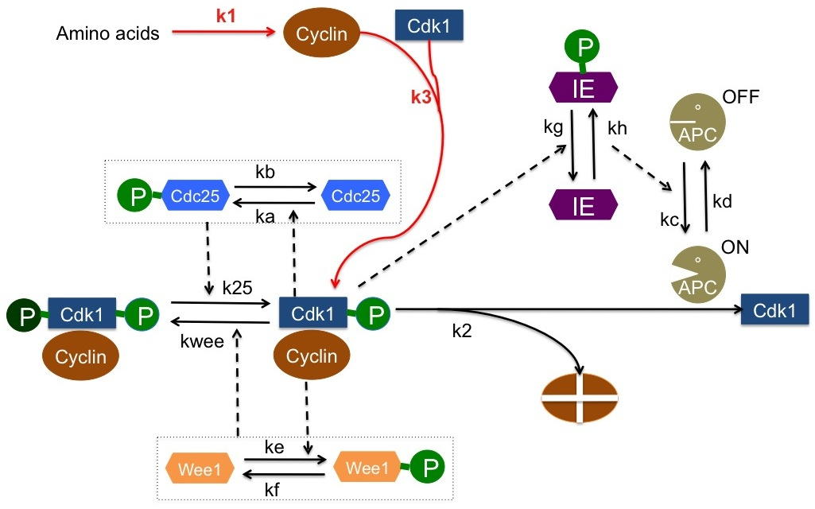
Mass action reaction rates
AA -> AA + Cyclin k1
Cyclin + Cdk -> MPF k3

Slide 21
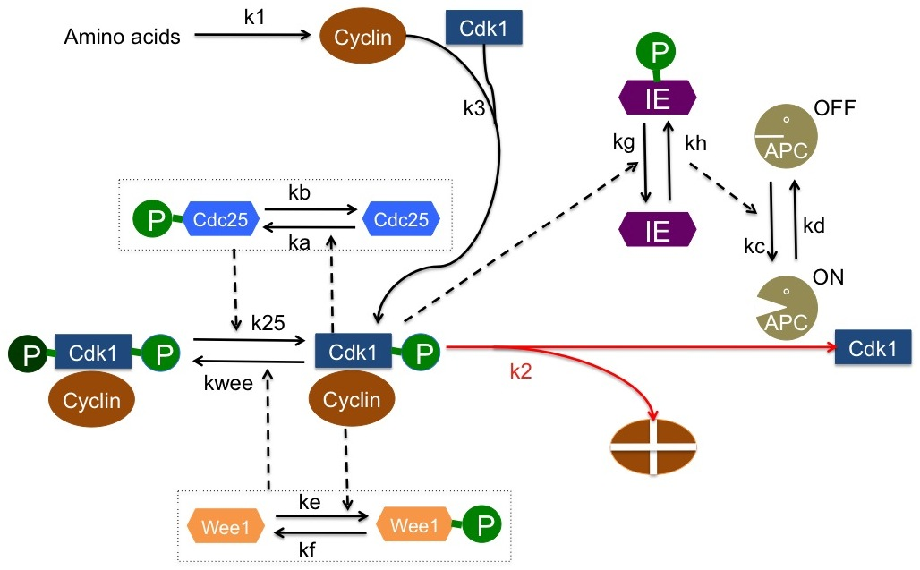
A rate dependent on the state of another protein
Two rules for each form of cyclin:
Cyclin + APCoff -> AA + APCoff V21
Cyclin + APCon -> AA +APCon V22
MPF + APCoff -> AA + Cdk + APCoff V21
MPF + APCon -> AA + Cdk + APCon V22
PreMPF + APCoff -> AA + Cdk + APCoff V21
PreMPF + APCon -> AA + Cdk + APCon V22
Notes:
V21 .005
V22 .25

Slide 22
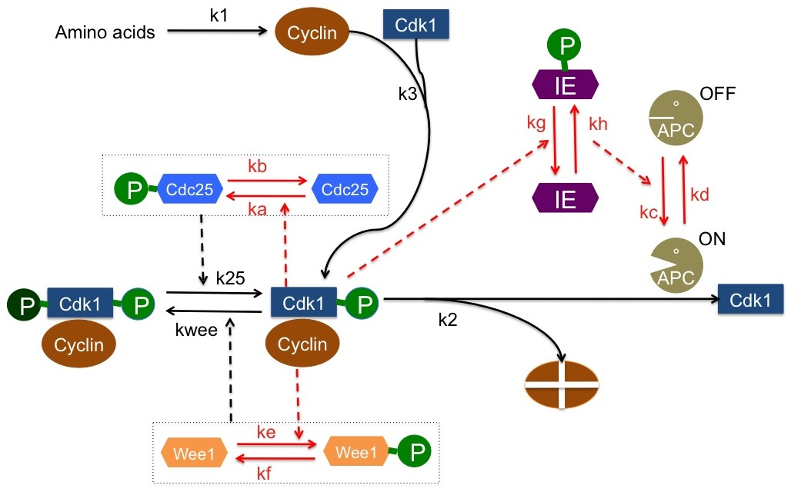
Catalytic reaction rates
All of the phosphorylation/dephosphorylation reactions work the same way:
Cdc25U + MPF -> Cdc25P + MPF Sat(ka,Ka)
Cdc25P + PPase -> Cdc25U + PPase Sat(kb,Kb)
APCoff + IEP -> APCon+IEP Sat(kc,Kc)
APCon + PPase -> APCoff + PPase Sat(kd,Kd)
Wee1U + MPF -> Wee1P + MPF Sat(ke,Ke)
Wee1P + PPase->Wee1U+PPase Sat(kf,Kf)
IEU+MPF->IEP+MPF Sat(kg,Kg)
IEP+PPase->IEU+PPase Sat(kh,Kh)
Notes:
Note that we actually need two parameters for Sat – these are provided by the paper.

Slide 23
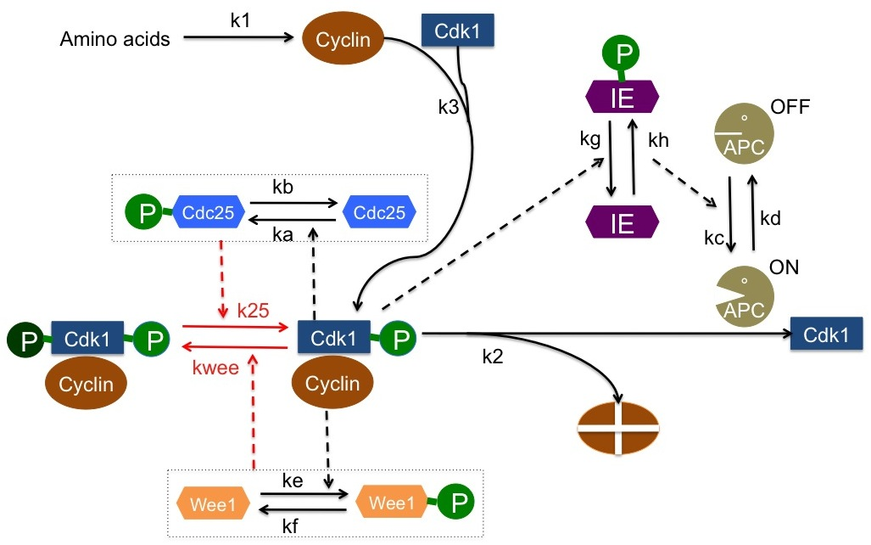
The MPF/PreMPF reactions
MPF + Wee1P ->PreMPF+Wee1P Vwee1
MPF +Wee1U -> PreMPF+Wee1U Vwee2
PreMPF+Cdc25P ->MPF +Cdc25P V252
PreMPF+Cdc25U->MPF+Cdc25U V251
Notes:
We provide two different rates for phosphorylated and dephosphorylated Wee1, using parameters given by the paper, and dividing to get number of molecules per cell (?)

Slide 24
The final rules
begin reaction rules
Rule0: I()->I()+Cyclin(deg~n) k1
Rule1: Cyclin(deg~n)+APC(c~OFF)->Cyclin(deg~y)+APC(c~OFF) V21
Rule2: Cyclin(deg~n)+APC(c~ON)->Cyclin(deg~y)+APC(c~ON) V22
Rule3: Cyclin(deg~n)+Cdk()->MPF(cyclin,cdk~1P) k3
Rule4: MPF(cyclin,cdk~*)+APC(c~OFF)->Cyclin(deg~y)+APC(c~OFF)+Cdk() V21
Rule5: MPF(cyclin,cdk~*)+APC(c~ON)->Cyclin(deg~y)+APC(c~ON)+Cdk() V22
Rule6: MPF(cyclin,cdk~1P)+Wee1(c~P)->MPF(cyclin,cdk~2P)+Wee1(c~P) Vwee1
Rule7: MPF(cyclin,cdk~1P)+Wee1(c~U)->MPF(cyclin,cdk~2P)+Wee1(c~U) Vwee2
Rule8: MPF(cyclin,cdk~2P)+Cdc25(c~P)->MPF(cyclin,cdk~1P)+Cdc25(c~P) V252
Rule9: MPF(cyclin,cdk~2P)+Cdc25(c~U)->MPF(cyclin,cdk~1P)+Cdc25(c~U) V251
Rule10: Cdc25(c~U)+MPF(cyclin,cdk~1P)->Cdc25(c~P)+MPF(cyclin,cdk~1P) Sat(ka,Ka)
Rule11: Cdc25(c~P)+PPase()->Cdc25(c~U)+PPase() Sat(kb,Kb)
Rule12: Wee1(c~U)+MPF(cyclin,cdk~1P)->Wee1(c~P)+MPF(cyclin,cdk~1P) Sat(ke,Ke)
Rule13: Wee1(c~P)+PPase()->Wee1(c~U)+PPase() Sat(kf,Kf)
Rule14: IE(c~U)+MPF(cyclin,cdk~1P)->IE(c~P)+MPF(cyclin,cdk~1P) Sat(kg,Kg)
Rule15: IE(c~P)+PPase()->IE(c~U)+PPase() Sat(kh,Kh)
Rule16: APC(c~OFF)+IE(c~P)->APC(c~ON)+IE(c~P) Sat(kc,Kc)
Rule17: APC(c~ON)+PPase()->APC(c~OFF)+PPase() Sat(kd,Kd)
end reaction rules

