Slide 1
Signaling Pathways
Ligands, Receptors, Binding, and Cascades
Naralys Batista
January 7, 2014
.
Funding for this workshop was provided by the program “Computational Modeling and Analysis of Complex Systems,” an NSF Expedition in Computing (Award Number 0926200).
Notes:
Example: When you’re on the train and there are a lot of people. If someone near you, no alarm. If someone pushes their way in, no alarm. If someone opens your bag alarm, if someone is touching you inappropriately there is an alarm.

Slide 2
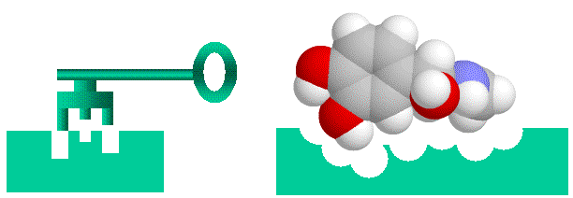
Ligands
A ligand is a molecule that binds and forms a complex with a biomolecule, usually a protein.
Ligands have particular shapes that allow them to bind to specific proteins.

Slide 3
Receptors
Receptors are the proteins that recognize specific ligands.
Receptors can be inside or outside of the cell depending on their function for the system.

Slide 4
Ligand Receptor Complexes
Protein complexes can behave differently depending on the kinds of ligands involved or if the protein is an enzyme.
Ion Channels
Extracellular Receptors (G-Coupled Protein Receptors or Tyrosine Kinase Receptors)
Enzyme Behaviors

Slide 5
Tyrosine Kinase Receptor
Tyrosine Kinase Receptors have two intracellular components that dimerize (aggregate) when the receptor is stimulated.
Notes:
Legs = tyrosine and have kinase activity

Slide 6
Ligand Protein Complex & Kinetics
k1
[Ligand] + [Receptor]
[Ligand . Receptor]
k2
The binding of ligand-protein complex is through non-covalent bond. This bond can be broken. The ligand can function as a messenger: once it triggers the protein and downstream process, it can leave the receptor.
Notes:
When dicussing k2, ask what would make me stop yelling @ the person who’s hand is in my purse? If their hand doesn’t come out of my purse, I keep yelling. So there must be a rate at which the complex separates.
If coffee is ligand, my hand receptor, and coffee is hot, will burn if I hold it forever.

Slide 7
Phosphorylation
Phosphorylation is simply the addition of a Phosphate group to a molecule.
Kinase is a protein that phosphorylates a molecule.
This usually activates a molecule.
P
P
P
P
P
P

