Slide 1
Welcome!
2014 CMACS Workshop on Modeling Biological Systems
Check under your keyboard for wireless access info

Slide 2
2014 CMACS Workshop on Modeling Biological Systems
Nancy Griffeth
Professor of Computer Science
Lehman College
January 6, 2014
Funding for this workshop was provided by the program “Computational Modeling and Analysis of Complex Systems,” an NSF Expedition in Computing (Award Number 0926200).
Notes:
This session is about two outreach efforts, to recruit graduate and undergraduate students to the field -- the Lehman undergraduate minority workshops and the curricular efforts. I have two major goals today, one to recruit some of you to help with these and the other to find out exactly what we’re recruiting students to.
I’ll describe about how we’re putting the workshops together -- mostly this has involved scrambling really fast to decide what the wrokshop is and to publicize it, and Jim and Chris have been a fantastic resources -- and then I’m going to open it up for discussion of the curricular effort.

Slide 3
What are we doing here?
Introductions
Preparation and recruiting for research internships and graduate school
Exposure to research projects
Interdisciplinary work experience
Learn a few things
Notes:
At a high level, what we get out of it

Slide 4
Today’s agenda
Agenda
Morning
Welcome and Paperwork
Introduction
12 noon Lunch
Afternoon
Modeling
Mac OS X and Unix
Notes:
Introductions
Logistics and paperwork
Workshop information
Schedule
Pedagogical approach

Slide 5
Staff
Introductions
Nancy Griffeth: professor of computer science at Lehman College
James Faeder: professor of computational and systems biology at the University of Pittsburgh
Terri Grosso-Applewhite: PhD student in computer science at the Graduate Center
Naralys Batista: Computer science major at Lehman, attended last year’s workshop
Notes:
None of us knows all of the material required – we have to rely on each other to get the work done
Go around and ask each to tell something about themselves

Slide 6
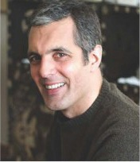
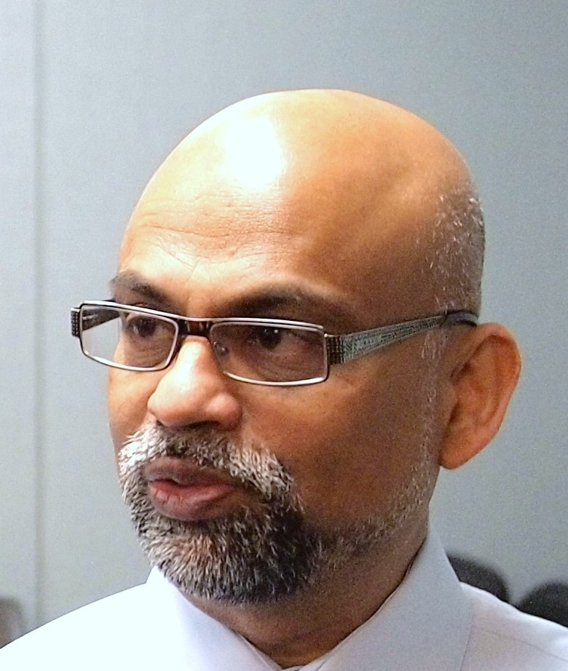
Visiting Lecturers
Stephen Redenti, professor
of biology at Lehman
Bud Mishra, professor of computer science and many other things at NYU

Slide 7
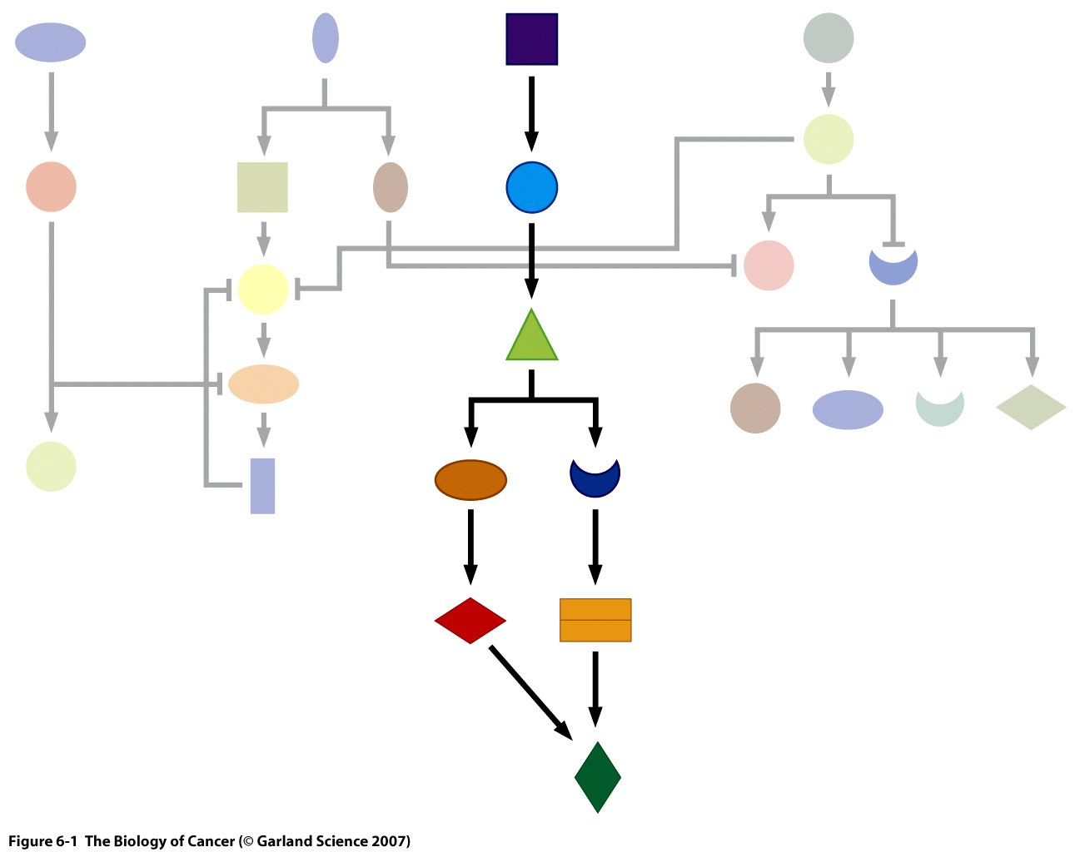
Subject Matter
Workshop Information
How to model signaling pathways, such as
those that control cell proliferation

Slide 8
Subject Matter
Mathematical modeling techniques and tools
Issues with and properties of mathematical models
Deterministic versus stochastic
Bistability

Slide 9
Who are you? (By college)
Introductions
Notes:
Go around with introductions
Question: What animal would you be if you were an animal?

Slide 10
Who are you? (By major)
Introductions

Slide 11
Who are you? (Type of major)

Slide 12
Participants
Introductions
Time to introduce yourselves…
What’s your college? Your major?
Exercise: Meet five of the other attendees – find out why they were interested in coming and what they expect to get out of the workshop.

Slide 13
Teaming: your primary interest
Logistics and paperwork
Biologist: understanding biological phenomena
Computational: using mathematical and/or computational techniques to understand biology
Chemist/physicist: using molecular behaviors to understand biological processes

Slide 14
Logistics
Logistics and paperwork
Crucial information:
Cafeteria
Coffee and snacks
Bathrooms
WiFi

Slide 15
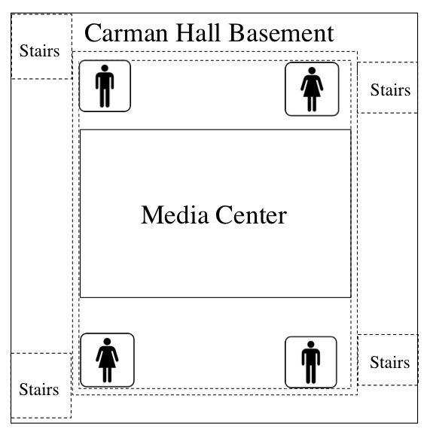
Maps
Logistics and paperwork
Campus Map
Carman Hall is at the southwest end of the campus

Slide 16
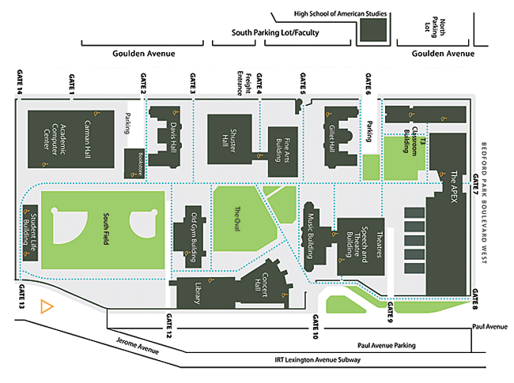
Tunnels
Logistics and paperwork

Slide 17
Paperwork
Logistics and paperwork
For stipend: Form 701
Teaming questionnaire (on-line)

Slide 18
Questions or Discussion?

Slide 19
Workshop Outline
Week 1: Biological and computational basics
Week 2: Modeling and computational tools
Week 3: Project

Slide 20
Today’s agenda
Agenda
Morning
Welcome and Paperwork
Introduction
12 noon Lunch
Afternoon
Modeling
Mac OS X and Unix
Notes:
Introductions
Logistics and paperwork
Workshop information
Schedule
Pedagogical approach

