Slide 1
Stochastic Markov Processes and Bayesian Networks
Aron Wolinetz

Slide 2
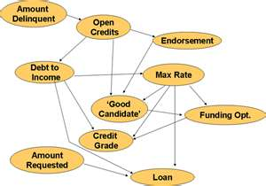
Bayesian or Belief Network
A probabilistic graphical model that represents a set of random variables and their conditional dependencies via a directed acyclic graph (DAG).
Will my student loan
get funded?

Slide 3
Bayesian Networks
All we need to add is some “chance” to the graph
Chance of rain given clouds?
P(R|C)
Chance of wet grass given rain?
P(W|R)

Slide 4
Network Example
Notes:
• An example (from California):
I’m at work, neighbor John calls to say my alarm is ringing,
but neighbor Mary doesn’t call. Sometimes it’s set off by
minor earthquakes. Is there a burglar?
• Variables: Burglar, Earthquake, Alarm, JohnCalls, MaryCalls
• Network topology reﬂects “causal” knowledge:
– A burglar can set the alarm off
– An earthquake can set the alarm off
– The alarm can cause Mary to call
– The alarm can cause John to call

Slide 5
Inference Tasks
Simple queries
Conjunctive queries
Optimality – P(outcome | action, evidence)
Value of information – what to do next
Sensitivity – which values are most important
Explanation – why do I need to do something

Slide 6
Inference by Enumeration
Go through every case using every variable with every probability
Grows exponentially with size of the network
Can become intractable
2⁵⁰ = 1X10¹⁵ > 1 day (at 1 billion calculations per second)

Slide 7
Inference by Stochastic Simulation
There must be a better way then enumeration.
Lets roll the dice and see what happens
I can calculate the odds of heads or tails, or I can flip a coin over and over and see what odds turn up.

Slide 8
Stochastic?
A system whose behavior is intrinsically non-deterministic.
A system’s subsequent state is determined by predictable actions and a random element.
Drunken sailor.

Slide 9
Stochastic Matrix
also called a probability matrix, transition matrix, substitution matrix, or Markov matrix
Matrix of non-negative, real numbers between 0 and 1 ( 0 ≤ X ≤ 1 )
Every row must total to 1

Slide 10
Stochastic Matrix
i, j represent: rows, column
The probability of going from state i to state j is equal to X_{i,j}
Or we can write P(j|i)= X_{i,j}
Five box cat and mouse game.

Slide 11
Cat and Mouse
Five Boxes [1,2,3,4,5]
Cat starts in box 1, mouse starts in box 5
Each turn each animal can move left or right, (randomly)
If they occupy the same box, game over (for the mouse anyway)

Slide 12
5 box cat and mouse game
States:
Stochastic Matrix:
State 1: cat in the first box, mouse in the third box: (1, 3)
State 2: cat in the first box, mouse in the fifth box: (1, 5)
State 3: cat in the second box, mouse in the fourth box: (2, 4)
State 4: cat in the third box, mouse in the fifth box: (3, 5)
State 5: the cat ate the mouse and the game ended: F.

Slide 13
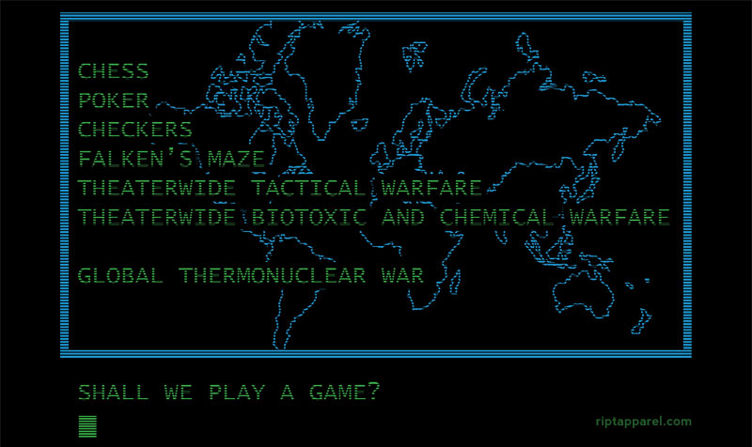
State Diagram of cat and mouse
State 2
State 3
State 1
State 5
State 5
State 4
State 5
Notes:
State two in green is the initial state
State five in blood red, is an accepting state
We can bounce around for a while, but eventually the mouse will die

Slide 14
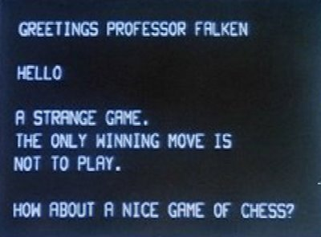
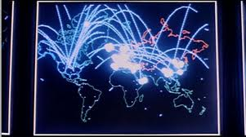
Instance of a game
State 2
C=1
State 3
C=2
State 2
C=1
M=5
M=4
M=5
State 3
C=2
M=4
State 4
C=3
M=5
State 5
C=4
M=4
This game consists of a chain of events
Lets call it a Markov Chain!

Slide 15
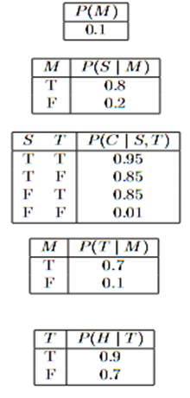
Stochastic System

Slide 16
Properties
How many numbers do we need to specify all the necessary probability values for the network?
How many would we need if there were no conditional independencies? (without the network)
Does the network cut down on our work?
Notes:
1+2+2+4+2 = 11
2⁵ ⁼³²

Slide 17
Frog Cell Cycle
Sible and Tyson figure 1 Methods 41 2007

Slide 18
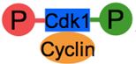
Frog Cell Cycle
Concentration or number of each of the molecule is a state.
Each reaction serves as a transition from state to state.
Whether or not a reaction will occur is Stochastic.
Notes:
Each state contains a complete picture of every species' quantity

Slide 19
Markov?
Andrey (Andrei) Andreyevich Markov
Russian Mathematician
June 14, 1856 – July 20, 1922

Slide 20
Markov Chain
Future is independent of the past given the present.
Want to know tomorrow’s weather? Don’t look at yesterday, look out the window.
Requires perfect knowledge of current state.
Very Simple, Very Powerful.
P(Future | Present)

Slide 21
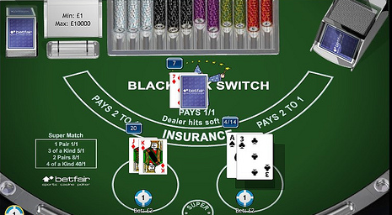
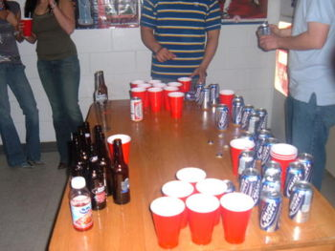
Markov Chain
Make predictions about future events given probabilities based on the current state.
Probability of the future, given the present.
Transition from state to state

Slide 22
First Order Markov Chain
Make a Markov assumption that the value of the current state depends
only on a fixed number of previous states
In our case we are only looking back to one previous state
X_{t} only depends on X_{t-1}

Slide 23
Second Order Markov Chain
Value of the current state depends on the two previous states
P(X_{t}|X_{t-1},X_{t-2})
The math starts getting very complicated
Can expand to third fourth… Markov chains

Slide 24
Stochastic Markov Chain
Drunken sailor.
Walk through the number line
Flip a coin, Heads +1, Tails -1 (50/50)
Stochastic Matrix
Notes:
From any position there are two possible transitions, to the next or previous integer. The transition probabilities depend only on the current position, not on the manner in which the position was reached. For example, the transition probabilities from 5 to 4 and 5 to 6 are both 0.5, and all other transition probabilities from 5 are 0. These probabilities are independent of whether the system was previously in 4 or 6.

Slide 25
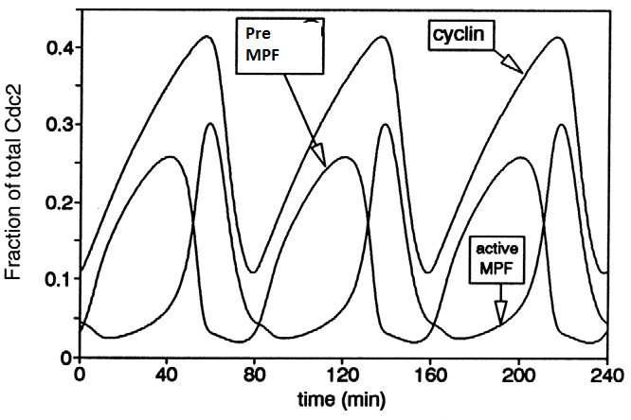
Back to the Frog Cell Cycle
State 1
Time = 0
#Cyclin = .1
State 2
#MPF = .05
Time = 20
#Cyclin = .25
#MPF = .15
State 3
Time = 40
#Cyclin = .35
#MPF = .25
State 4
Time = 60
#Cyclin = .4
#MPF = .1
State 5
Time = 80
#Cyclin = .15
#MPF = .5
#PMPF = .3
#PMPF = .5
#PMPF = .05
#PMPF = .025
#PMPF = .05

Slide 26
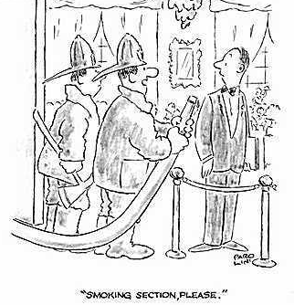
Hidden Markov Models
Sometimes we have an incomplete view of the world.
However, where there is smoke, there is usually fire.
We can use what we observe to make inferences about the present, or the future.

Slide 27
Hidden Markov Models
Let (Z₁, Z₂ … Z_{n}) be our “hidden” variables.
Let (X₁, X₂ … X_{n}) be what we observe.
This is what an HMM looks like
Z₁
Z₂
X₂
Z₃
X₃
X₄
X₁
Z₄
Z₅
X₅

Slide 28
Components of an HMM
States (Hidden)
Observations
Starting Probability - Where might we begin
Transition Probability - From state to state
Emission Probability- Given a state, probability of observable actions occurring.

Slide 29
Handwriting analysis using HMM
Hidden states – What letter does the writer intend.
Observation – What chicken scratch did the person scribble.
Starting probability – There are 26 letters, some are more likely to start a word.
Emission probability – What letters are likely to follow other letters (stochastic matrix)

Slide 30
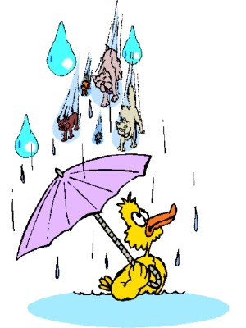
Lets predict the weather
On day 0 it is sunny and beautiful [1 0]
Day 0 times Transition Matrix = Day 1
[1 0] * = [.9 .1] (90% chance of sun)
Day 1 times Transition Matrix
= Day 2 [.86 .14]
What if we took this to ∞?
= [.833 .167]

Slide 31
Steady State
Requires a regular transition matrix (at least one row of all non zero entries)
Is independent of the starting state
Represents the probability of all days
83% of days are sunny

Slide 32
Poisson Process
A stochastic process which counts the number of events and the time that these events occurred.
Independent increments – the numbers of occurrences counted in disjoint intervals are independent from each other.
Stationary increments - the probability distribution of the number of occurrences counted in any time interval only depends on the length of the interval.
No counted occurrences are simultaneous.

Slide 33
Poisson Process
The number of raindrops falling within a specified area
The number of particles emitted via radioactive decay by an unstable substance
The number of requests for individual documents on a web server
Number of goals scored in a hockey Game

Slide 34
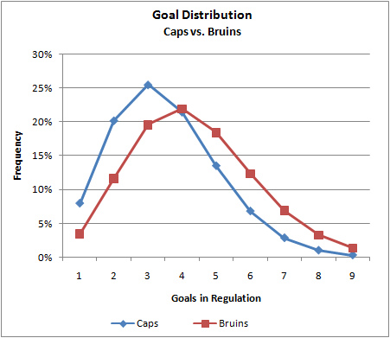
Poisson Process

Slide 35
WAKE UP!!! I’M DONE

