Slide 1
Unit conversions

Slide 2
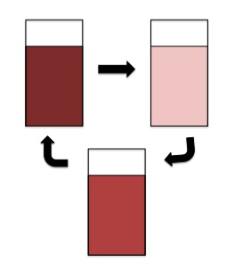
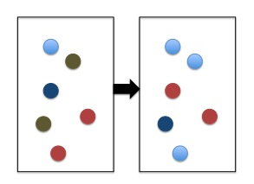
Stochastic versus ODE
ODE
Stochastic

Slide 3
Units
With concentrations* (ODE simulations only):
concentrations (eg moles/liter) for species
Unit concentration / unit time for reactions
With particles (ODE or stochastic):
Number of molecules for species
Reaction firings per unit time
* Usual way that measurements are reported in the literature.

Slide 4
Concentrations <-> Particles
NA = Avogadro’s Number, V=volume
Concentration C -> C*N_{A}*V particles
Particles P -> P/(N_{A}*V) concentration (eg moles/liter)

Slide 5
Mass Action
A->C, rate k1:
[C] = k1[A]: Units of k1 must be /time
A+B->C, rate k2:
[C] = k2[A][B]: Units of k2 must be /conc/time
->C, rate k0:
[C] = k0: Units of k0 must be conc/time

Slide 6
Unimolecular reactions A -> B
Concentrations
Particles
A->B k1
Units: /time
A->B k1’
Units: /time
Conversion: k1’ = k1

Slide 7
Avogadro’s constant
The Avogadro constant (N_{A}) is defined as the ratio of the number of constituent particles N (usually atoms or molecules) in a sample to the amount of substance n (unit mole) through the relationship
N_{A} = N/n
Wikipedia
N_{A} = 6.02214129×10²³ mol−1

Slide 8
Bimolecular reactions
Concentrations
Particles
A+B -> C k2
Units: /conc/time
A+B -> C k2’
Units: /time
Conversion: k2’ = k2/(NA*V)

Slide 9
Constant Reaction
Concentrations
Particles
-> C k0
Units: conc/time
-> C k0’
Units: /time
Conversion: k0’ = k0*(NA*V)

Slide 10
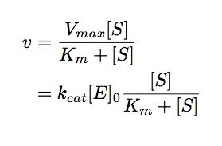
Review: Michaelis Menten

Slide 11
Special Feature
explicit enzyme::
S + E -> P + E Sat(kcat,Km)
Implicit enzyme(!):
S -> P Sat(Vmax,Km)

Slide 12
Use the second method if…
a) the enzyme is unknown
b) the enzyme concentration is large and constant, and the user intends to run network-free simulations with NFsim.

Slide 13
Enzymatic Conversions
kcat' = kcat
Vmax' = Vmax*NA*V
Km' = Km*NA*V

Slide 14
Also…
explicit enzyme: S + E -> P + E kcat/(Km + Stot)
implicit enzyme: S -> P Vmax/(Km + Stot)
Stot is an observable, giving the amount (concentration or #particles) of S
Multiply reactant quantities times the formula

