Slide 1
Derivation of the Nernst Equation:
$ln\frac{{[C]}_{r}}{{[C]}_{l}}$=($V_{l}{−V}_{r}$)

Slide 2
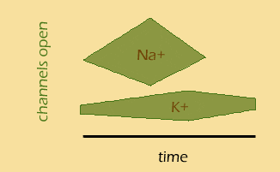

Slide 3
Why else do we care?

Slide 4
What else?
Other health conditions besides atrial fibrillation may result from problems with membrane potential:
1)Cystic fibrosis—poor chloride movement across the membranes
2)Epilepsy may be due to poorly working voltage gated channels

Slide 5
Intuitive picture for Flux

Slide 6
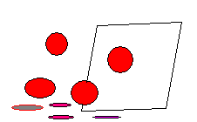
We start with diffusive flux:
Concentration per volume=mol/cm^3* 1/cm

Slide 7
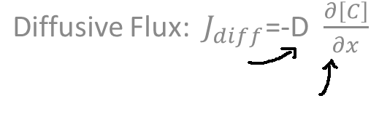
Putting them together:
$$Electric Drift:{ J}_{Drift=}\text{−} μz[C]\frac{∂V}{∂x}$$
$\frac{{cm}^{2}}{s}$ $\frac{mol}{{cm}^{4}}$ $\frac{{cm}^{2}}{Vs}$ $\frac{mol}{{cm}^{3}}$ $\frac{V}{cm}$

Slide 8
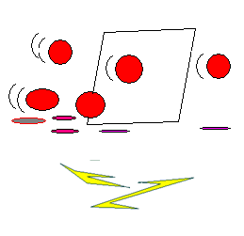
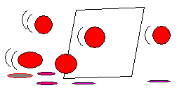
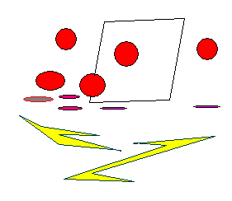
Combining the Drift and the Diffusion:
$J_{Drift +}$ $J_{Diff=}$-D$\frac{∂[C]}{∂x}$ -$μz[C]\frac{∂V}{∂x}$:

Slide 9
Getting everything in terms of mobility:
Replace D with the Boltzmann constant : D= $\frac{kT}{q}μ$
$J_{Total=}$- $\frac{kT}{q}μ\frac{∂[C]}{∂x}$ -$μz[C]\frac{∂V}{∂x}$

Slide 10
More on the Boltzmann constant from Wikipedia:
The Boltzmann constant (k or k_{B}) is a physical constant relating energy at the individual particle level with temperature. It is the gas constant R divided by the Avogadro constant N_{A}.
k=R/ N_{A}
(See thermally agitated molecule)

Slide 11
Looking more like it: Replace $\frac{kT}{q}μ$ with $\frac{RT}{F}μ$
$J_{Total=}$-$\frac{RT}{F}μ\frac{∂[C]}{∂x}$ -$μz[C]\frac{∂V}{∂x}$
R is the ideal gas constant and
F is the Faraday constant

Slide 12
More on the Faraday constant from Wikipedia: (one mole of electrons)
In physics and chemistry, the Faraday constant (named after Michael Faraday) is the magnitude of electric charge per mole of electrons.^{[1]} It has the currently accepted value
F = 96,485.3365(21) C/mol.^{[2]} The constant F has a simple relation to two other physical constants:
where: F=eN_{A}
e ≈ 1.6021766×10⁻⁻¹⁹ C;^{[3]} N_{A} ≈ 6.022141×10²³ mol⁻¹.^{[4]} N_{A} is the Avogadro constant (the ratio of the number of particles 'N' to the amount of substance 'n' - a unit mole), and e is the elementary charge or the magnitude of the charge of an electron.

Slide 13
One Mole of Particles:

Slide 15
Multiply both sides by F and z:
F*z*($J_{Total }$)=F*z* (- $μ\frac{RT}{F}\frac{∂[C]}{∂x}$ -$μz[C]\frac{∂V}{∂x}$)

Slide 16
Cross out F in the diffusive flux; add the factor z in the drift expression

Slide 17
Current Flux:
$I_{current flux}$= - $μzRT\frac{∂[C]}{∂x}$ -$μ{Fz}^{2}[C]\frac{∂V}{∂x}$
$$\frac{Coul.∗valence}{{cm}^{2}s}$$

Slide 18
Set equation=0 to get Nernst equation (no current)
0 = - $μzRT\frac{∂[C]}{∂x}$ -$μFz^{2} [C]\frac{∂V}{∂x}$

Slide 19
Factor out - $μz$
0= - $μz(RT\frac{∂[C]}{∂x}$ +$Fz [C]\frac{∂V}{∂x}$)
(We see that -$μz is a solution, so we can get rid of it.$)

Slide 20
Now we have the variables we want:
$\text{0}\text{=}RT\frac{∂[C]}{∂x}$ + $Fz [C]\frac{∂V}{∂x}$

Slide 21
Move the diffusive flux term over to the LHS
-$RT\frac{∂[C]}{∂x}$ $\text{=}Fz[C]\frac{∂V}{∂x}$

Slide 22
Divide by -RT/Fz:
$\frac{∂[C]}{∂x}$ $\text{=−}\frac{Fz}{RT}[C]\frac{∂V}{∂x}$

Slide 23
Separation of Variables:
$\frac{∂[C]}{∂x}$ $\text{=}\text{−}\frac{Fz}{RT}[C]\frac{∂V}{∂x}$
Becomes
$\frac{∂[C]}{[C]∂x}$ $\text{=}\text{−}\frac{Fz}{RT}\frac{∂V}{∂x}$
$$\int{\frac{∂[C]}{[C] }}\text{=}\text{−}\frac{Fz}{RT}\int{∂V}$$

Slide 24
Integration:

Slide 25
Goldman-Hodgkin

Slide 26
A little applet
http://www.nernstgoldman.physiology.arizona.edu/#download

