Slide 1
Group 5- Penta
Maruf, Nanda, Ruth

Slide 2
Primary Focus of Group 5:
The primary focus of group 5 was to record and observe the affect on the spiral waves as a result of changing the G_{ks} and G_{Na} percent values.

Slide 3
G_{Na}
The G_{Na} represents the maximal conductance of the sodium ions. Increasing or decreasing the percentage of the G_{Na} has a direct effect on the fast Na⁺ current.
I_{Na}= G_{Na}m³hj(V-E_{Na})
When increasing the maximal conductance of sodium the overall current of sodium entering the cell increases, and when decreasing the maximal conductance the current decrease.

Slide 4
G_{ks}
The G_{ks} represents the maximal conductance of the potassium ions. As mentioned above the increase or decrease in percentage of the maximal conductance, effects the increase or decrease of the overall current- slow delayed rectifier current.
I_{ks}=G_{ks}x_{s}² (V-E_{ks} )

Slide 5
Methods :
The G_{ks} and G_{Na} were changed each one at a time, where at least 5 rotations were separating between each change of the parameter value.
When the values were changed they were changed in increments of 20% at a time.
The group collected two sets of data were in each case a different path, or different order of plugging the data was followed.

Slide 6
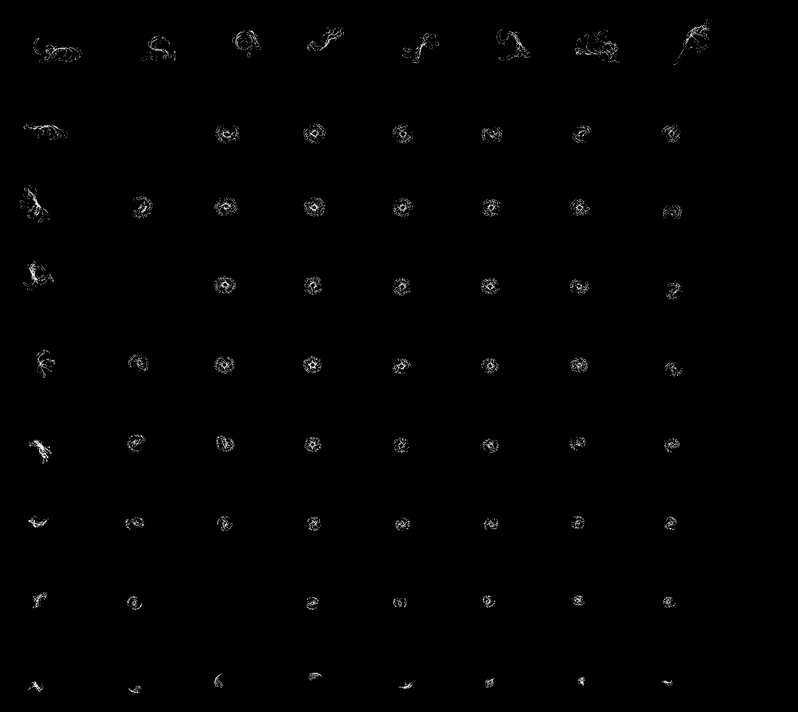

Slide 7
Observations:
When increasing the maximal conductance of sodium, and decreasing the G_{ks} the tip trajectory needed to travel a longer distance, before returning in the other direction. It could be observed that the figure of the path becomes larger with increasing G_{Na} and keeping G_{ks} constant at 25%

Slide 8
When increasing the G_{ks} and keeping the G_{Na} at 25% the tip trajectory travel a shorter distance. It could be observed that the figure of the path covers a smaller area with increasing G_{ks} and keeping G_{Na} constant at 25%

Slide 9
When keeping the ratio constant it seems that the figure assumed a stable rotating wave.
Most of the images produced a flower like rotation. Thus the non flower looking capture our attention.
We can notice that in the extreme values of G_{Na} the path looks different from the rest of the graph.
In the case of G_{ks} it seems that only the minimum bound had a significant effect on the way the image looked like.

Slide 10
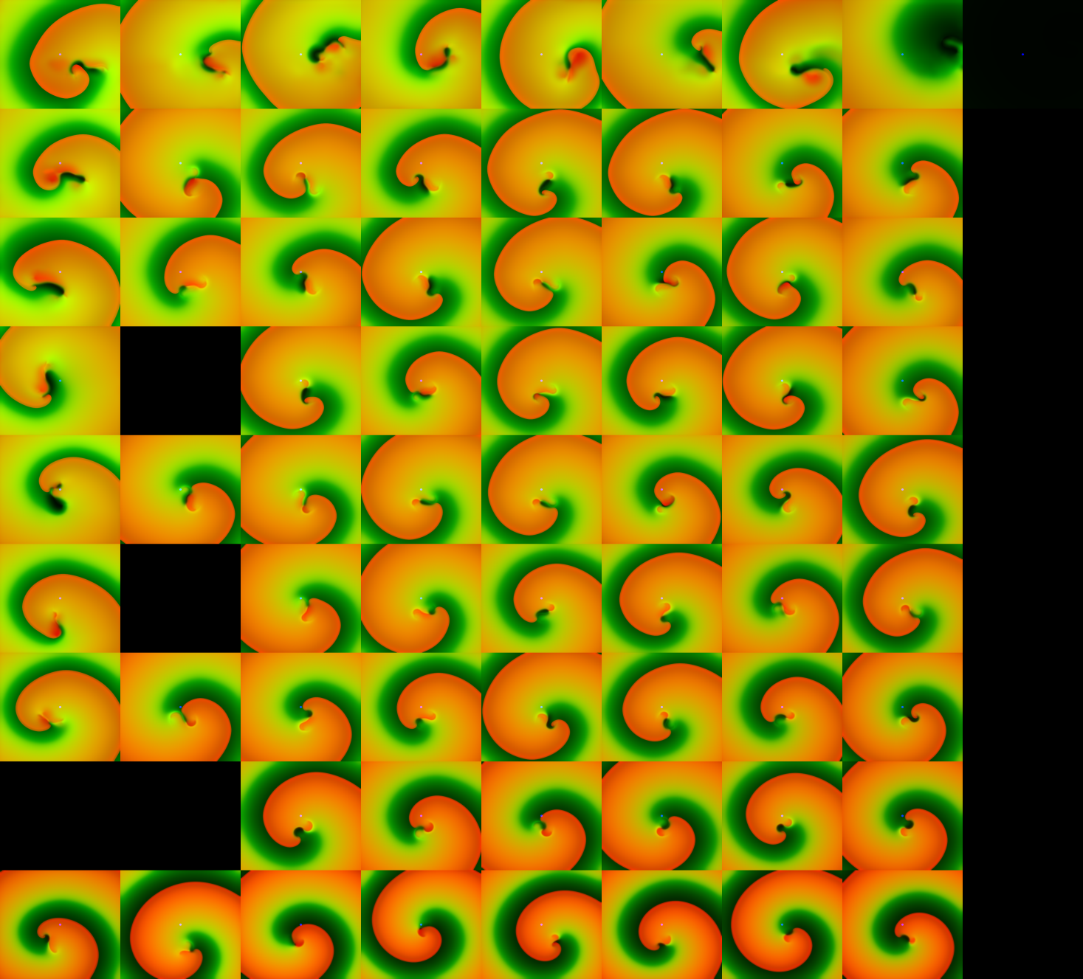

Slide 11
When looking on the wave’s graph the main differences that stand out are that when the G_{Na} is at 25% the wave is smaller and there is clear distinctions between the different colors present. Whereas the upper bound of G_{Na} looks larger, and the colors are not that pronounced

Slide 12
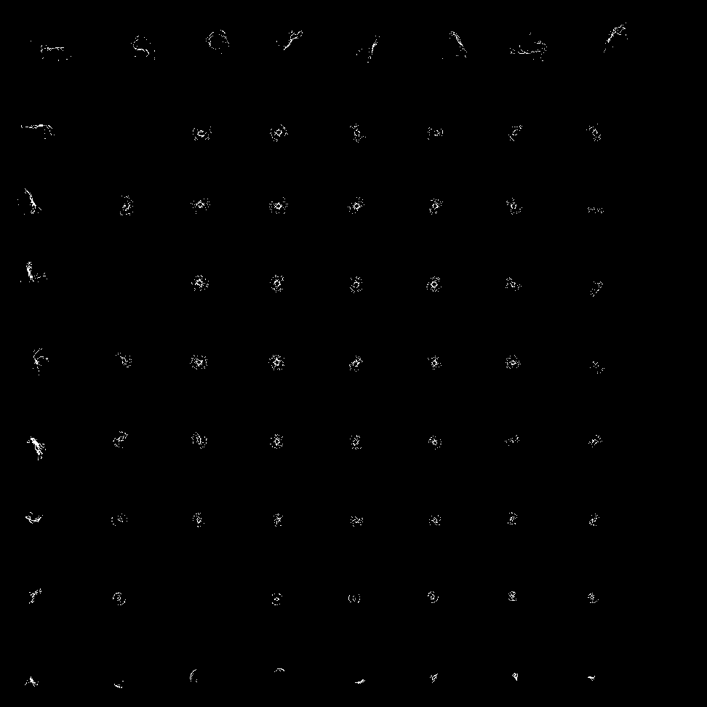
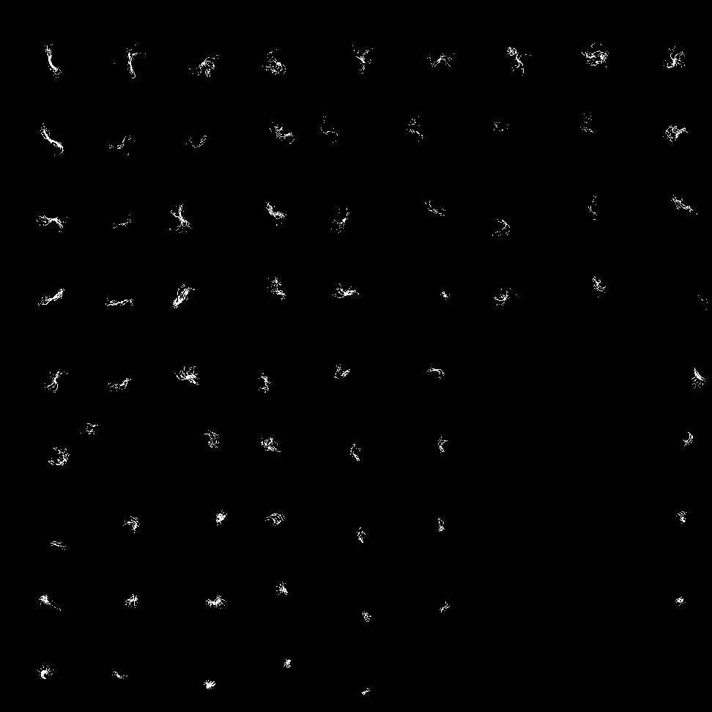
Graph of two different paths: The two graphs don’t look identical at all.

Slide 13

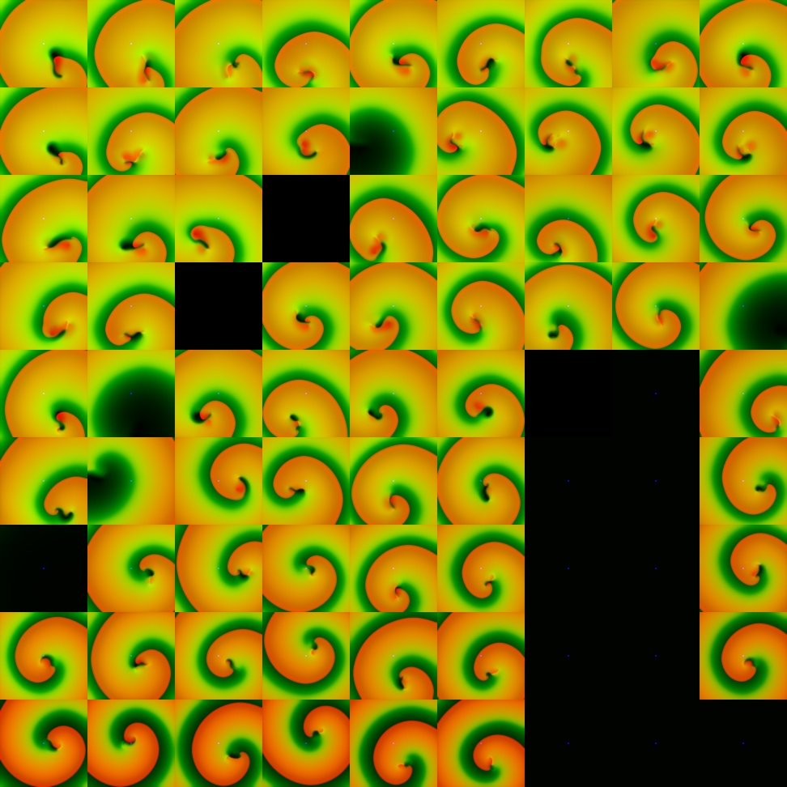
The wave stooped existing in some points, but in the same exact points on the other graph the wave still exist.

Slide 14
Trying to make sense of the observation:
As we learned the increase of Na ions cause the inside of the cell to become depolarized ( more positive). When the action potential reaches its peak the potassium flow into the cell and lower the voltage back to its resting potential.
It is important to notice that I_{ks} is not the only potassium current available, and even when adjusting the percentage to 25% there are other currents that help facilitate returning to the resting potential state.

Slide 15
Longer path- the increase of sodium causes the action potential to happen rapidly, thus a large area is excited at the same time this allows for the action potential propagation to last longer.
Since less potassium flow in when reducing the percentage, the period of the action potential will be longer and it will take more time to get to a resting state.
Cells that are still excited cannot be excited again, and since the propagation is farther and the duration is longer the tip will need to take a longer path before rotating back.

Slide 16
Shorter path- more potassium the faster the resting potential is resorted. Thus the tip does not need to travel as much, since the cell can be excited again.
Wave wider or narrower- do to the propagation of the action potential. When all parts of the membrane excite at the same time it creates a stronger pulse. Like when you throw a pebble to the ocean as compared to a big stone.
Graph are not identical, and different points makes the wave disappear- when presenting this question to Bard Ermentrout he suggested that it might be that there are different solutions. What we understood from this comment was that according to the current condition of the wave it might be that its stable point is closer to another solution when taking different paths.

Slide 17
Conclusion:
Changing the parameters did affect the shape of the tip trajectory as well as the shape of the wave. Some of the results that we recorded were not reproduced, and further repetitions will need to be taken.
It seems that lower G_{ks} has more effect than increasing it, but we will need to have more information on how does the slow delayed rectifier current behave, and interact with the other potassium currents.
With G_{Na} values it looks like both extreme points had an effect on the tip trajectory as well as the shape of the wave.

Slide 18
Thank You!

