Slide 1
Automata
Nancy Griffeth
January 7, 2014
Funding for this workshop was provided by the program “Computational Modeling and Analysis of Complex Systems,” an NSF Expedition in Computing (Award Number 0926200).

Slide 2
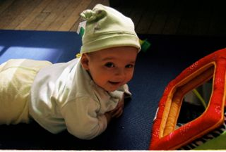
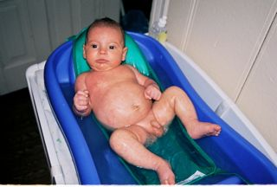
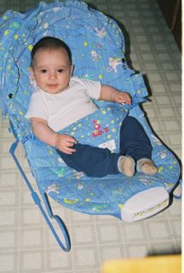
States and transitions
Bathe
Get
dressed
Sit
Get dressed and sit
Sleep
Wake
up

Slide 3
Variant 1
Bathe
Get dressed by Mom
Get dressed by Dad
Sit
Get dressed and sit
Sleep
Wake
up
Notes:
In this variant, multiple edges between states

Slide 4
Variant 2
Bathe
Get dressed
Sit
Get dressed
Sleep
Notes:
In this variant, nondeterministic transitions (get dressed can end in either of two places)

Slide 5
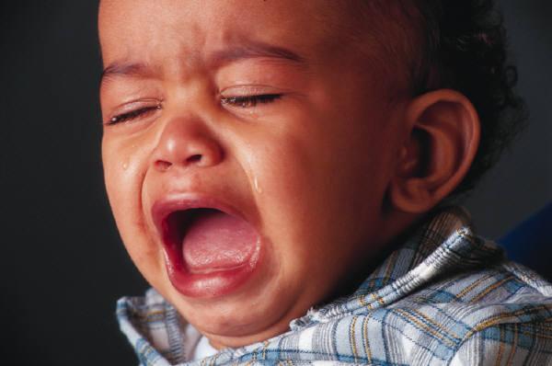
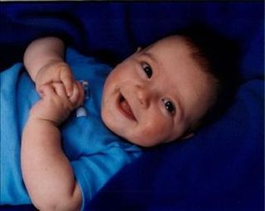
States as combinations
Activity
Mood
and
Notes:
Often, states are represented as combinations of the values of variables. This doesn’t really relate to the rest of the talk.

Slide 6
Applications
Parsing (for compilers or other software)
Verifying program correctness (model-checking)
Modeling anything

Slide 8
Stages/States
SSG: Self-sufficiency in growth signals
IAG: Insensitivity to anti-growth signals
Ang: Sustained angiogenesis
LRP: Limitless replicative potential
Ev Ap: Evading Apoptosis
M: Metastasis

Slide 9
A Possible Drug Therapy
VEGF signals for creation of new blood vessels
The drug Avastin inhibits the VEGF signaling pathway
This prevents tumors from getting an adequate blood supply

Slide 10
Using Avastin
Avastin
inhibits VEGF pathway
Normal
Notes:
Ideally after application of Avastin it would go back to the normal state; however, oxygen-starved tumor cells can become more invasive

Slide 12
Evaluating therapies
Cost?
Pareto optimality
Other properties?
Model-checking:
Metastasis is never reached
Following angiogenesis, evading apoptosis is never acquired
Notes:
Simple explanation:
If we are looking at cost on one dimension and benefit on another, Pareto-optimality means we can’t reduce the cost without reducing the benefit, and
Can’t increase the cost without increasing the benefit
Arbitrary logical properties of the state machine (e.g., never reach metastasis):
Model-checking – a usuallly (in practice) efficient technique of solving an NP-complete problem, of testing the satisfiability of a property
Bud Mishra, who will speak later in the workshop, wrote the first paper on model-checking

Slide 13
Model shortcomings
Ignores time
In pancreatic cancer, about a year for K-ras mutations to lead to abnormal growth of tissue
Seventeen years for a large benign tumor to evolve into an advanced cancer
Two years within the advanced cancer for cells to metastasize
Drugs completely switch off transitions

Slide 14
Adding time
Use a collection of clocks.
Clock rates may be different and can change independently!!
Time measured by heartbeats
Time measured by bars
Time measured by turns
Notes:
Think of clocks not as absolute time on the wall, but as measuring various things – like a clock based on someone’s heart ratetbeats; based on lungs, so many breaths

Slide 15
Adding time
Time is measured by a collection of clocks
State invariants: Maximum time on each clock in a given state
Transition constraints: Time on each clock in origin state before transition can happen
Drug effects: How the drug affects clocks
Notes:
May not have an invariant or constraint on every clock

Slide 16
Timed Automata

Slide 17
Time invariants for transitions
Trans:
t≥120
Trans:
Scrub ≥15
Trans: Head turns ≥60
Trans:
Scrub≥10
Trans:
t≥30
Trans:
Breaths≥1000

Slide 18
Time constraints for states
Head turns≥100
Scrub≥30
t≥120
Breaths≥2000

Slide 19
Drug effects
Oatmeal: reduce head turns by 50%, breaths by 10%
Milk: reduce head turns by 75%, breaths by 20%
Sugar: double head turns and breaths
Valium (administered to Mom): reduce Scrub by 50%
Trans:
t≥120
Head turns≥100
Scrub≥30
Trans:
Scrub ≥15
Trans: Head turns ≥60
t≥120
Trans:
Scrub≥10
Breaths≥2000
Trans:
t≥30
Trans:
Breaths≥1000

Slide 20
Notes:
Note: each state is really the union of all the states so far
Can have mulltiple edges between states

Slide 21
CHA Therapy
Avastin: slows clock B by .5
Can’t leave state until clock B reaches 2
4
2
SSG
IAG
Ang
4
Can only stay in state until clock A reaches 4

