Slide 1
Numerical Integration Techniques
A Brief Introduction

Slide 2
Objectives
Start Writing your OWN Programs
Make Numerical Integration accurate
Make Numerical Integration fast
CUDA acceleration

Slide 3

The same Objective
Lord, make me accurate and fast.
- Mel Gibson, Patriot

Slide 4
Schedule

Slide 5
Preliminaries
Basic Calculus
Derivatives
Taylor series expansion
Basic Programming Skills
Octave
Notes:
Bad Joke: Exponential function e to x and constant 1 is walking on some street. They find differential operator walking to them. Constant 1 is very nervous, he said I will become 0 if I meet the differential operator. The exponential function said, I am good at this. And he go to say hello to the differential operator. He says, hello, I am the exponential function e to the x. The reply was “Hi, and I am df/dy”.
Stokes’ Theorem
Octave is just a Matlab Lite. Biologists -> analyze data, mathematician -> the only two software: mathematica, matlab

Slide 6
Numerical Differentiation
Definition of Differentiation
Problem: We do not have an infinitesimal h
Solution: Use a small h as an approximation

Slide 7
Numerical Differentiation
Forward Difference
Approximation Formula
Is it accurate?

Slide 8
Numerical Differentiation
Error Analysis
Taylor Series expansion uses an infinite sum of terms to represent a function at some point accurately.
which implies

Slide 9
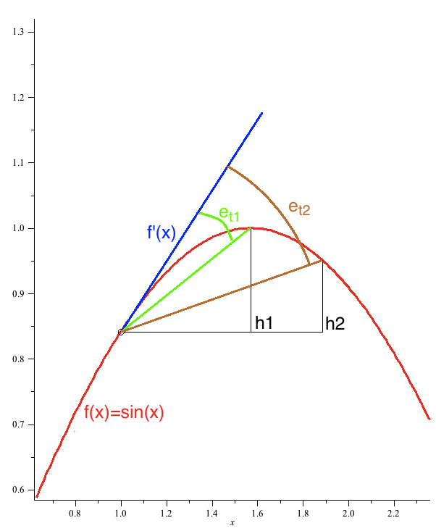
Truncation Error

Slide 10
Numerical Differentiation
Error Analysis
Roundoff Error
A computer can not store a real number in its memory accurately.
Every number is stored with an inaccuracy proportional to itself.
Denoted
Total Error
Usually we consider Truncation Error more.

Slide 11
Numerical Differentiation
Backward Difference
Definition
Truncation Error
No Improvement!

Slide 12
Numerical Differentiation
Central Difference
Definition
Truncation Error
More accurate than Forward Difference and Backward Difference

Slide 13
Numerical Differentiation
Example
Compute the derivative of function
At point x=1.15
Notes:
Differentiation.m compares the errors of these methods

Slide 14
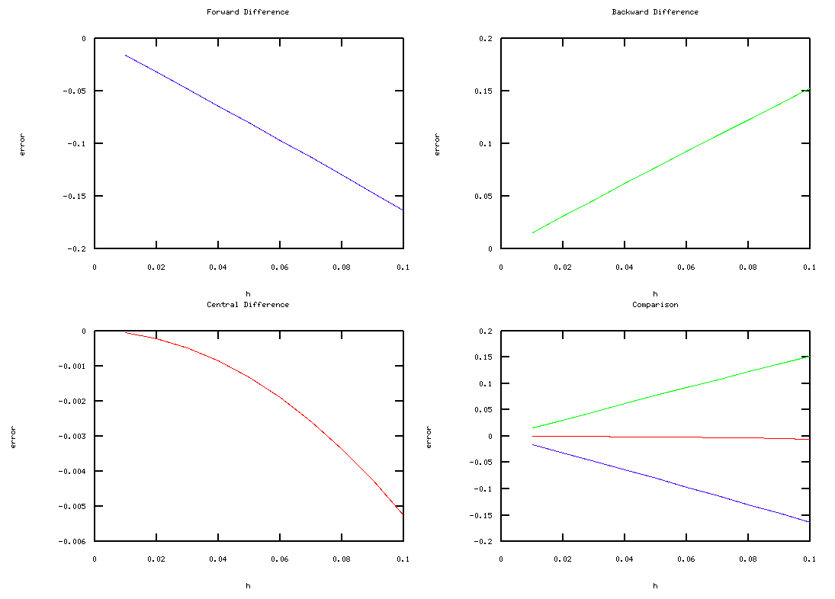
Use Octave to compare these methods
Blue – Error of Forward Difference
Green – Error of Backward Difference
Red – Error of Central Difference

Slide 15
Numerical Differentiation
Multi-dimensional & High-Order
Multi-dimensional
Apply Central Difference for different parameters
High-Order
Apply Central Difference several times for the same parameter

Slide 16
Euler Method
IVP
The Initial Value Problem
Differential Equations
Initial Conditions
Problem
What is the value of y at time t?

Slide 17
Euler Method
Explicit Euler Method
Consider Forward Difference
Which implies

Slide 18
Euler Method
Explicit Euler Method
Split time t into n slices of equal length Δt
The Explicit Euler Method Formula

Slide 19
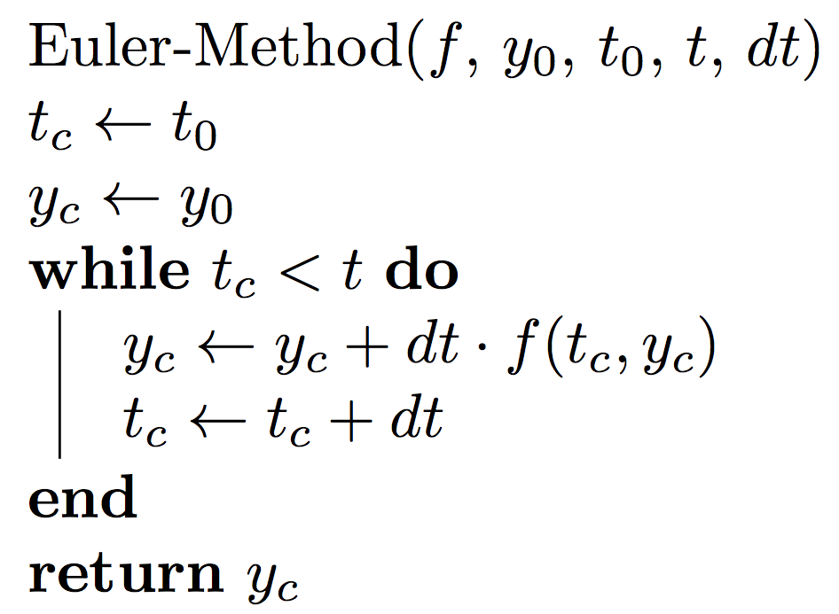
Euler Method
Explicit Euler Method - Algorithm

Slide 20
Euler Method
Explicit Euler Method - Error
Using Taylor series expansion, we can compute the truncation error at each step
We assume that the total truncation error is the sum of truncation error of each step
This assumption does not always hold.

Slide 21
Euler Method
Implicit Euler Method
Consider Backward Difference
Which implies

Slide 22
Euler Method
Implicit Euler Method
Split the time into slices of equal length
The above differential equation should be solved to get the value of y(t_{i+1})
Extra computation
Sometimes worth because implicit method is more accurate

Slide 23
Euler Method
A Simple Example
Try to solve IVP
What is the value of y when t=0.5?
The analytical solution is
Notes:
Ask students to write the explicit Euler method formula

Slide 24
Euler Method
A Simple Example
Using explicit Euler method
We choose different dts to compare the accuracy

Slide 25
Euler Method
A Simple Example
t | exact | dt=0.05 | error | dt=0.025 | error | dt=0.0125 | error
0.1 | 1.10016 | 1.10030 | 0.00014 | 1.10022 | 0.00006 | 1.10019 | 0.00003
0.2 | 1.20126 | 1.20177 | 0.00050 | 1.20151 | 0.00024 | 1.20138 | 0.00011
0.3 | 1.30418 | 1.30525 | 0.00107 | 1.30470 | 0.00052 | 1.30444 | 0.00025
0.4 | 1.40968 | 1.41150 | 0.00182 | 1.41057 | 0.00089 | 1.41012 | 0.00044
0.5 | 1.51846 | 1.52121 | 0.00274 | 1.51982 | 0.00135 | 1.51914 | 0.00067
At some given time t, error is proportional to dt.

Slide 26
Euler Method
Instability
For some equations called Stiff Equations, Euler method requires an extremely small dt to make the result accurate
The Explicit Euler Method Formula
The choice of Δt matters!

Slide 27
Euler Method
Instability
Assume k=5
Analytical Solution is
Try Explicit Euler Method with different dts
Notes:
Euler_instable.m

Slide 28
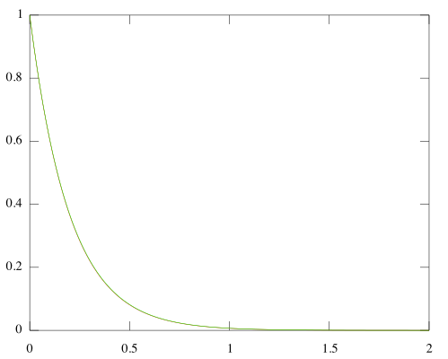
Choose dt=0.002, s.t.
Works!

Slide 29
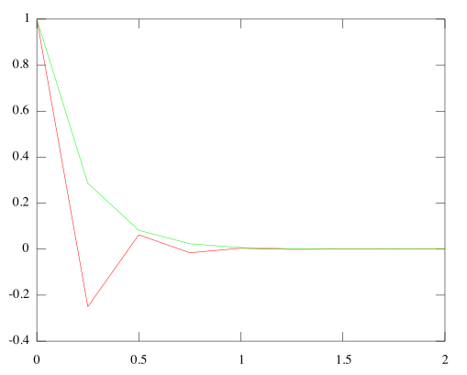
Choose dt=0.25, s.t.
Oscillates, but works.

Slide 30
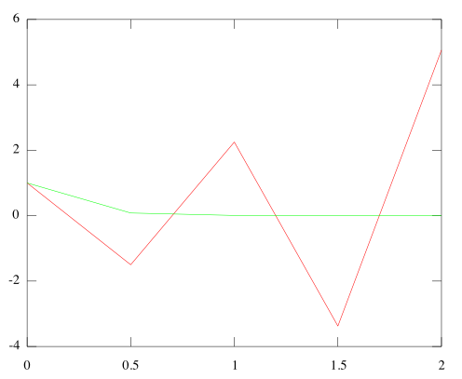
Choose dt=0.5, s.t.
Instability!

Slide 31
Euler Method
Stiff Equation – Explicit Euler Method
For large dt, explicit Euler Method does not guarantee an accurate result
t | exact | dt=0.5 | error | dt=0.25 | error | dt=0.002 | error
0.4 | 0.135335 | 1 | 6.389056 | -0.25 | 2.847264 | 0.13398 | 0.010017
0.8 | 0.018316 | -1.5 | 82.897225 | -0.015625 | 1.853096 | 0.017951 | 0.019933
1.2 | 0.002479 | 2.25 | 906.714785 | -0.000977 | 1.393973 | 0.002405 | 0.02975
1.6 | 0.000335 | -3.375 | 10061.73321 | -0.000061 | 1.181943 | 0.000322 | 0.039469
2 | 0.000045 | 5.0625 | 111507.9831 | 0.000015 | 0.663903 | 0.000043 | 0.04909

Slide 32
Euler Method
Stiff Equation – Implicit Euler Method
Implicit Euler Method Formula
Which implies

Slide 33
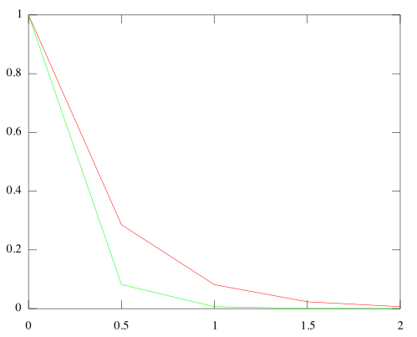
Choose dt=0.5,
Oscillation eliminated!
Not elegant, but works.
Notes:
Euler_instable_implicit.m

Slide 34
The Three-Variable Model
Single Cell
The Differential Equations

Slide 35
The Three-Variable Model
Single Cell
Simplify the model

Slide 36
The Three-Variable Model
Single Cell
Using explicit Euler method
Select simulation time T
Select time slice length dt
Number of time slices is nt=T/dt
Initialize arrays vv(0, …, nt), v(0, …, nt), w(0, …, nt) to store the values of V, v, w at each time step
Notes:
Threevariable.m

Slide 37
The Three-Variable Model
Single Cell
At each time step
Compute p,q from value of vv of last time step
Compute Ifi, Iso, Ifi from values of vv, v, w of previous time step

Slide 38
The Three-Variable Model
Single Cell
At each time step
Use explicit Euler method formula to compute new vv, v, and w

Slide 39
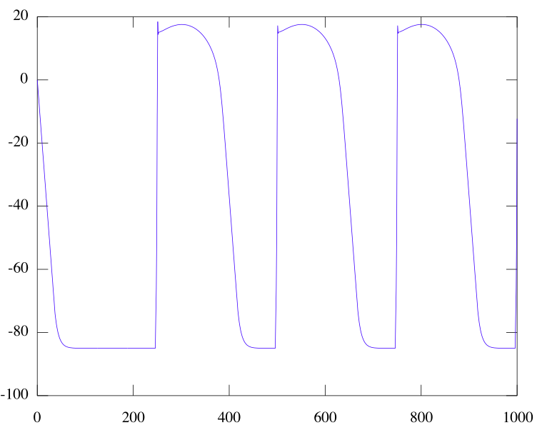
The Three-Variable Model

Slide 40
Heat Diffusion Equations
The Model
The first equation describes the heat conduction
Function u is temperature distribution function
Constant α is called thermal diffusivity
The second equation initial temperature distribution

Slide 41
Heat Diffusion Equation
Laplace Operator
Laplace Operator Δ (Laplacian)
Definition: Divergence of the gradient of a function
Divergence measures the magnitude of a vector field’s source or sink at some point
Gradient is a vector point to the direction of greatest rate of increase, the magnitude of the gradient is the greatest rate

Slide 42
Heat Diffusion Equation
Laplace Operator
Meaning of the Laplace Operator
Meaning of Heat Diffusion Operator
At some point, the temperature change over time equals the thermal diffusivity times the magnitude of the greatest temperature change over space

Slide 43
Heat Diffusion Equation
Laplace Operator
Cartesian coordinates
1D space (a cable)

Slide 44
Heat Diffusion Equation
Laplace Operator
Compute Laplacian Numerically (1d)
Similar to Numerical Differentiation

Slide 45
Heat Diffusion Equation
Laplace Operator
Boundaries (1d), take x=0 for example
Assume the derivative at a boundary is 0
Laplacian at boundaries

Slide 46
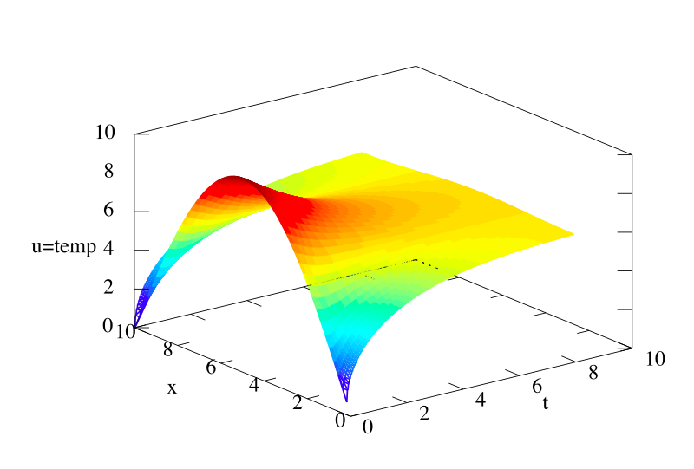
Heat Diffusion Equation
Exercise
Write a program in Octave to solve the following heat diffusion equation on 1d space:

Slide 47
Heat Diffusion Equation
Exercise
Write a program in Octave to solve the following heat diffusion equation on 1d space:
TIPS:
Store the values of u in a 2d array, one dimension is the time, the other is the cable(space)
Use explicit Euler Method
Choose dt, dx carefully to avoid instability
You can use mesh() function to draw the 3d graph

Slide 48
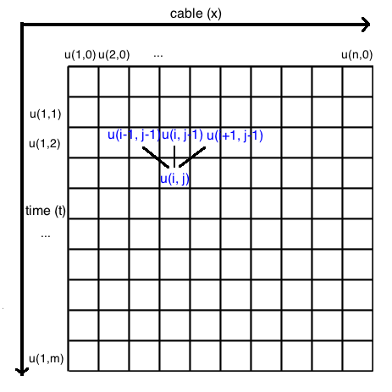
Store u in a two-dimensional array
u(i,j) stores value of u at point x=x_{i}, time t=t_{j}.
u(i,j) is computed from u(i-1,j-1), u(i,j-1), and u(i+1,j+1).

Slide 49
Heat Diffusion Equation
Explicit Euler Method Formula
Discrete Form

Slide 50
Heat Diffusion Equation
Stability
dt must be small enough to avoid instability

Slide 51
The END
Thank You!

