Slide 1
Navigating the IRB & IDEATE at Lehman College
Lisa Peralta
Research Programs Manager
Lehman College

Slide 2
What is research?
Research is defined as a systematic investigation, including pilot research, testing and evaluation, designed to develop or contribute to generalized knowledge. Activities that meet this definition constitute research that needs to receive IRB approval before the research can begin.
WHAT IS AN IRB?
An IRB (Institutional Review Board for human participants) is a group of at least five individuals with varying backgrounds who promote, complete, and adequately review of research studies. An IRB conducts the initial and annual reviews of a research study.

Slide 3
Overview
Training www.citiprogram.org
Types of Review
Informed Consent
IDEATE www.ideate.cuny.edu
Guiding Student Research
CUNY HRPP Policies and Procedures
Research NYC Department of Education

Slide 4
CITI Training (www.citiprogram.org)
Human Subjects
Initial certificate is valid for three years and a refresher course is required every 3 years.
Be sure to take the Behavioral and Social Research section as an Investigator
CITI certification needs to be submitted as an attachment in the IRB application.

Slide 5
Types of IRB Review
Full/Convened (high risk)
Expedited (minimal risk)
Exempt (low risk)
Not Human Subjects Research

Slide 6
Full/Convened IRB Review
Research that cannot meet the criteria for exempt or expedited review must be submitted for full review. It can include:
More than minimal risk (physical, psychological, social or economic).
Vulnerable populations (when applicable)

Slide 7
Expedited Research Category 1
Clinical studies of drugs and medical devices only when condition (a) or (b) is met.
(a) Research on drugs for which an investigational new drug application (21 CFR Part 312) is not required. (Note: Research on marketed drugs that significantly increases the risks or decreases the acceptability of the risks associated with the use of the product is not eligible for expedited review.)
(b) Research on medical devices for which (i) an investigational device exemption application (21 CFR Part 812) is not required; or (ii) the medical device is cleared/approved for marketing and the medical device is being used in accordance with its cleared/approved labeling.

Slide 8
Expedited Research Category 2
Collection of blood samples by finger stick, heel stick, ear stick, or venipuncture as follows:
from healthy, non-pregnant adults who weigh at least 110 pounds. For these subjects, the amounts drawn may not exceed 550 ml in an 8 week period and collection may not occur more frequently than 2 times per week; or
from other adults and children, considering the age, weight, and health of the subjects, the collection procedure, the amount of blood to be collected, and the frequency with which it will be collected. For these subjects, the amount drawn may not exceed the lesser of 50 ml or 3 ml per kg in an 8 week period and collection may not occur more frequently than 2 times per week.

Slide 9
Expedited Research Category 3
Prospective collection of biological specimens for research purposes by noninvasive means. Examples: (a) hair and nail clippings in a nondisfiguring manner; (b) deciduous teeth at time of exfoliation or if routine patient care indicates a need for extraction; (c) permanent teeth if routine patient care indicates a need for extraction; (d) excreta and external secretions (including sweat); (e) uncannulated saliva collected either in an unstimulated fashion or stimulated by chewing gumbase or wax or by applying a dilute citric solution to the tongue; (f) placenta removed at delivery; (g) amniotic fluid obtained at the time of rupture of the membrane prior to or during labor; (h) supra- and subgingival dental plaque and calculus, provided the collection procedure is not more invasive than routine prophylactic scaling of the teeth and the process is accomplished in accordance with accepted prophylactic techniques; (i) mucosal and skin cells collected by buccal scraping or swab, skin swab, or mouth washings; (j) sputum collected after saline mist nebulization.

Slide 10
Expedited Research Category 4
Collection of data through noninvasive procedures (not involving general anesthesia or sedation) routinely employed in clinical practice, excluding procedures involving x-rays or microwaves. Where medical devices are employed, they must be cleared/approved for marketing. (Studies intended to evaluate the safety and effectiveness of the medical device are not generally eligible for expedited review, including studies of cleared medical devices for new indications.)
Examples: (a) physical sensors that are applied either to the surface of the body or at a distance and do not involve input of significant amounts of energy into the subject or an invasion of the subjects privacy; (b) weighing or testing sensory acuity; (c) MRI; (d) ECG, EEG, thermography, detection of naturally occurring radioactivity, ERG, ultrasound, diagnostic infrared imaging, doppler blood flow, and echo; (e) moderate exercise, muscular strength testing, body composition assessment, and flexibility testing where appropriate given the age, weight, and health of the individual.

Slide 11
Expedited Research Category 5
Research involving materials (data, documents, records, or specimens) that have been collected, or will be collected solely for nonresearch purposes (such as medical treatment or diagnosis).
Expedited Research Category 6
Collection of data from voice, video, digital, or image recordings made for research purposes.

Slide 12
Expedited Research Category 7
Research on individual or group characteristics or behavior (including, but not limited to, research on perception, cognition, motivation, identity, language, communication, cultural beliefs or practices, and social behavior) or research employing survey, interview, oral history, focus group, program evaluation, human factors evaluation, or quality assurance methodologies.

Slide 13
Exempt Research Review
Does NOT mean you are exempt from IRB review.
The PI must still submit a Request for Exemption.
Exempt Review status means you are exempt from continuing review (annual review)
Approved for three (3) years.
Must resubmit request for exemption before 3 years is up.

Slide 14
Exempt Research Category 1
Research conducted in established or commonly accepted educational settings, involving normal educational practices, such as (a) research on regular and special education instructional strategies or (b) research on the effectiveness of or the comparison among instructional techniques, curricula or classroom management methods.

Slide 15
Exempt Research Category 2
Research involving the use of educational tests (cognitive, diagnostic, aptitude, achievement), survey procedures, interview procedures or observation of public behavior, unless:
information obtained is recorded in such a manner that subjects can be identified, directly or through identifiers linked to the subjects and
any disclosure of the human subjects' responses outside the research could reasonably place the subjects at risk of criminal or civil liability or be damaging to the subjects' financial standing, employability or reputation.

Slide 16
Exempt Research Category 3
Research involving the use of educational tests (cognitive, diagnostic, aptitude, achievement), survey procedures, interview procedures, or observation of public behavior that is not exempt under paragraph (2), if:
the human subjects are elected or appointed public officials or candidates for public office
federal statute(s) require(s) without exception that the confidentiality of the personally identifiable information will be maintained throughout the research and thereafter.

Slide 17
Exempt Research Category 4
Research involving the collection or study of existing data, documents, records, pathological specimens, or diagnostic specimens, if these sources are publicly available or if the information is recorded by the investigator in such manner that subjects cannot be identified, directly or through identifiers linked to the subjects.

Slide 18
Exempt Research Category 5
Research and demonstration projects which are conducted by or subject to the approval of (federal) department or agency heads and which are designed to study, evaluate or otherwise examine:
a. public benefit or service programs,
b. procedures for obtaining benefits or services under those programs
c. possible changes in or alternatives to those programs or procedures
d. possible changes in methods or levels of payment for benefits or services under those programs.

Slide 19
Exempt Research Category 6
Taste and food quality evaluation and consumer acceptance studies, if:
wholesome foods without additives are consumed or
if a food is consumed that contains a food ingredient at or below the level and for a use found to be safe, or agricultural chemical or environmental contaminant at or below the level found to be safe, by the FDA or approved by the EPA or the Food Safety and Inspection Service of the U.S.D.A.

Slide 20
Not Human Subjects Research
Research - A systematic investigation (the gathering and analysis of information) designed to develop or contribute to generalizable knowledge.
Human Subject - A living individual about whom an investigator conducting research obtains 1) data through intervention or interaction with the individual, or 2) identifiable private information.
Publicly available dataset that does NOT require special permissions.
Data about living individuals from an existing data set, where identity cannot be readily ascertained or associated with data.
Class project for a grade that will not be disseminated outside the classroom.

Slide 21
Not Human Subjects Research
Evaluation of a program for quality improvement with NO plans to publish or present the results outside of CUNY.
Data from death records or about non-living individuals.
Limited to an analysis of a single case report where findings may or may not be generalized.
Open-ended interviews that ONLY document a specific historical event or the experience of individuals without the intent to draw conclusions or generalize findings.

Slide 22
Informed Consent
As per the CUNY policy and procedures:
Researchers are required to legally obtain informed consent of each research participant or their legally authorized representative, unless the IRB has granted the researcher a waiver or alteration of informed consent

Slide 23
Informed Consent Process
To ensure an effective informed consent process the following should be implemented:
The consent form occurs in a way that ensures the participant’s privacy
The information is provided to the participant in a language that is understandable to them.
Participant’s are given adequate opportunity to consider participation
Researcher’s ensure that all the participant’s questions are answered
Researcher must be sure that the participant fully understands the information that they are receiving

Slide 24
Informed Consent Process
The participant must voluntary provide their consent before any activities occur
Participants are aware that they can ask questions about their participation at any time during the study and they can choose to withdraw from the study at any time.
Be sure that the individual obtaining the consent is well versed in the project and the participant population

Slide 25
Informed Consent Form Template
If your study will require informed consent, there is a CUNY Informed Consent Form Template that is required to be used by all researchers.
The template can be found on the CUNY Research Compliance website. The link is a follows: http://www2.cuny.edu/research/research-compliance/human-research-protection-program-hrpp/hrpp-policies-procedures/#1460557807503-ffb0df78-c58c

Slide 26
Informed Consent Waiver
A Request for Waiver of Consent can be filed for your expedited or convened study if it meets the following criteria:
The research involves no more than minimal risk to the subjects.
The waiver or alteration will not adversely affect the rights and welfare of the subjects.
The research could not practicably be carried out without the waiver or alteration.
Whenever appropriate, the subjects will be provided with additional pertinent information after participation.

Slide 27
A Request for Waiver of Consent
CanNOT apply to:
Research that involves non-viable neonates as subjects.
Research that involves experimental subjects in DoD research.
Pertinent research not regulated by the FDA.

Slide 28
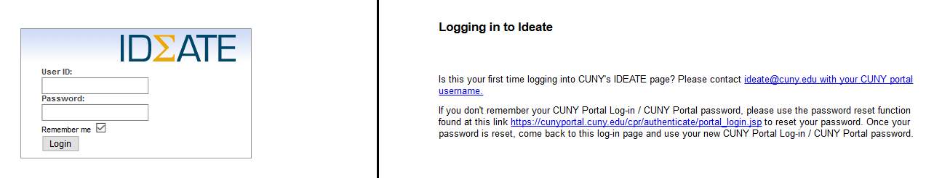
IDEATE (www.ideate.cuny.edu)
Registration
First time registration email ideate@cuny.edu to request a user profile (include your CUNY affiliation, CUNY email address and CUNY portal username in the email, )
Once a profile has been created for you, you will receive a notification via email. You will use your CUNY PORTAL credentials to access IDEATE (https://ideate.cuny.edu). Please allow 2 to 3 business days for your profile to be created.

Slide 29
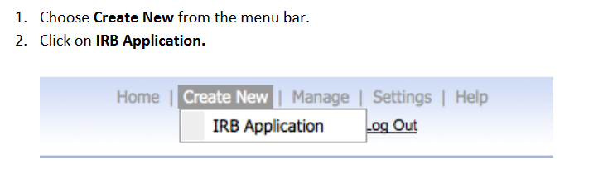
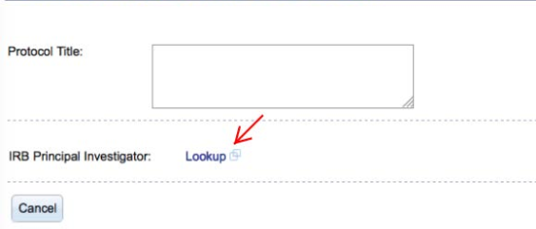
Creating a new project in IDEATE
After logging into ideate.cuny.edu with your CUNY portal username, choose “Create New” from the menu bar at the top of the web page.
Next click on “IRB Application”.
3. Enter the Protocol Title in the field provided
4. Click on Lookup to select the Principal Investigator

Slide 30
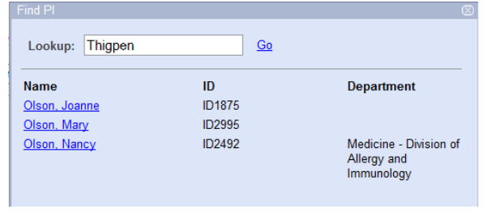

Creating a new project in IDEATE
The Find PI popup screen is displayed. Enter the last name of the Principal Investigator in the Lookup field provided.
Click “Go” to locate the profile
Click on the name to select the Principal Investigator
Select the Department by clicking on the dropdown list provided and clicking on a value.
Click “Begin Application” when all information has been entered.
Click “Cancel”at any time to abandon the process.

Slide 31
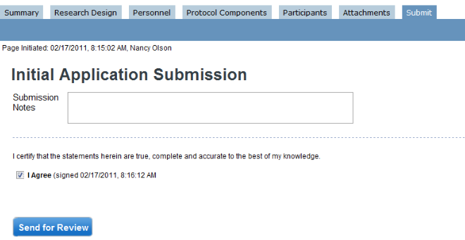
Submitting an IRB application in IDEATE
Complete each question contained within each of the tabs and subtabs in the application
When all questions have been addressed navigate to the “Submit” tab
Enter any desired “Submission Notes” in the field provided
Check the “I Agree” checkbox to agree to the certification statement
Click “Send for Review”

Slide 32
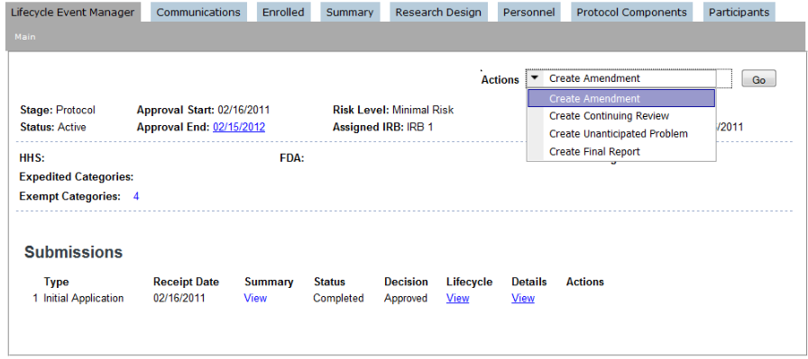
SUBMITTING AN Amendment/continuing review/event in Ideate
*An Amendment may only be created for an Active protocol*
Open the protocol in IDEATE
Navigate to the Lifecycle Event Manager: Main tab.
In the “Actions” field, click from the drop down which action you want to create.
Click the “Go” button to the right of the Actions field

Slide 33
IRB guidance for Principal investigators and faculty advisors

Slide 34
Who Can Be A Principal Investigator?
Full time CUNY faculty and staff may be Principal Investigators on IRB applications
CUNY adjunct faculty must obtain approval from their Provost prior to being a Principal Investigator on an IRB application
CUNY students and postdocs can serve as Principal Investigators with permission and supervision from their faculty advisor or research program director

Slide 35
Faculty Advisors responsbilities:
Assist students with protocol submission. Help students navigate the IRB Process.
When proposed activities constitute research with human subjects, it is the responsibility of the faculty advisor to assist students in preparing and reviewing materials to be submitted to the IRB.
Responsible for reviewing the scientific integrity of the project, including evaluating the scientific rigor and merit of the study.
Educate Students on the role of the CUNY IRB and the importance of research review. Students must complete the CITI training for human subjects & RCR before submitting an application to the IRB.
Maintain ethical standards.
Faculty advisors ensure that projects are conducted in the highest ethical standards and that students understand and implement these ethical standards in the conduct of their research.

Slide 36
Faculty Advisors responsbilities:
Take an active role in the IRB review process and assist students when presented with questions and comments from the IRB or my office.
Ensure that before a change is implemented to an approved protocol that it is approved by the IRB. All changes must be reviewed by the faculty mentor before submission to the IRB.
Report any adverse events or other research related problems to my office as soon as possible.
Ensure that continuing review requirements are satisfied when applicable and ensure the study is closed at the conclusion of the study.
Lisa Peralta
X7870
Shuster 306
lisa.peralta@lehman.cuny.edu
hrpp.administrator@lehman.cuny.edu

Slide 37
Resources
To access the CUNY Research Compliance Program which also includes the CUNY HRPP Policy and Procedures outlined in this PowerPoint presentation, go to:
http://www2.cuny.edu/research/research-compliance/
This presentation as well as information on research at Lehman College is available on the Lehman website:
http://www.lehman.edu/institutional-review-board/index.php

Slide 38
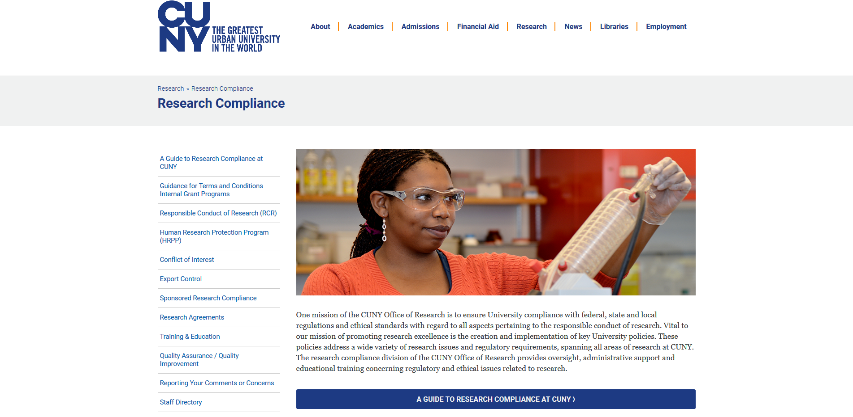

Slide 39
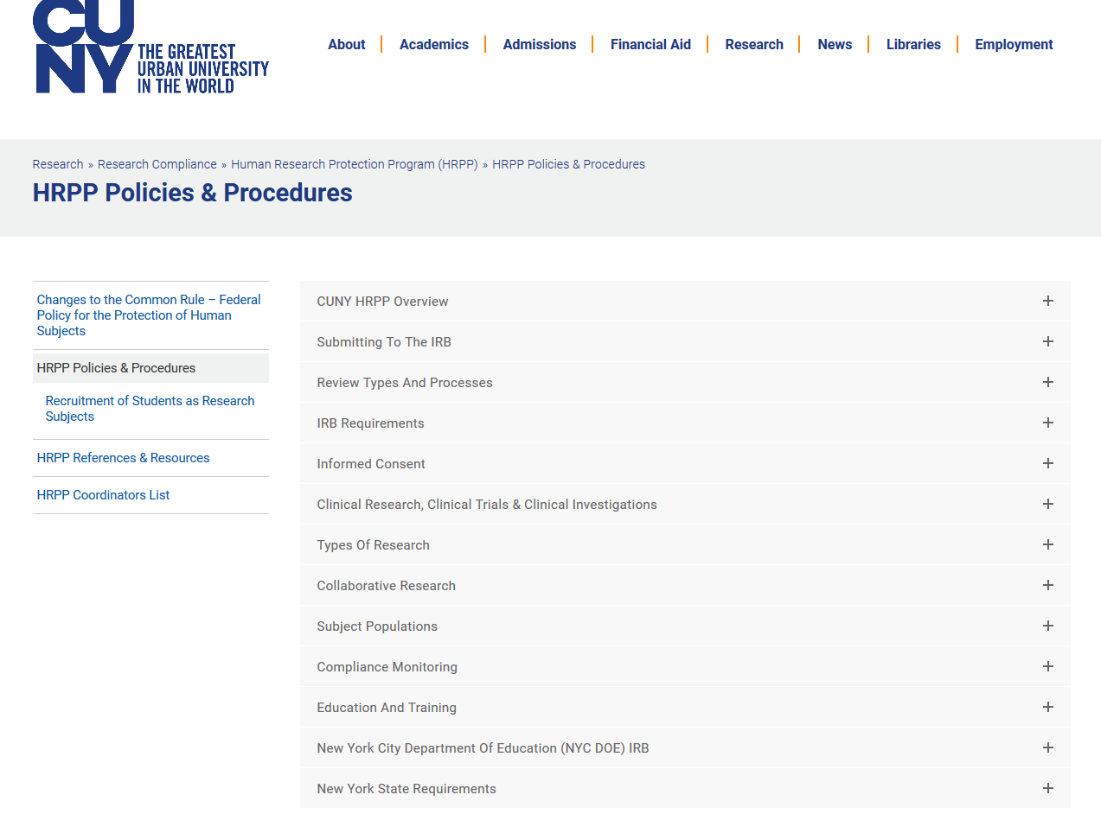

Slide 40
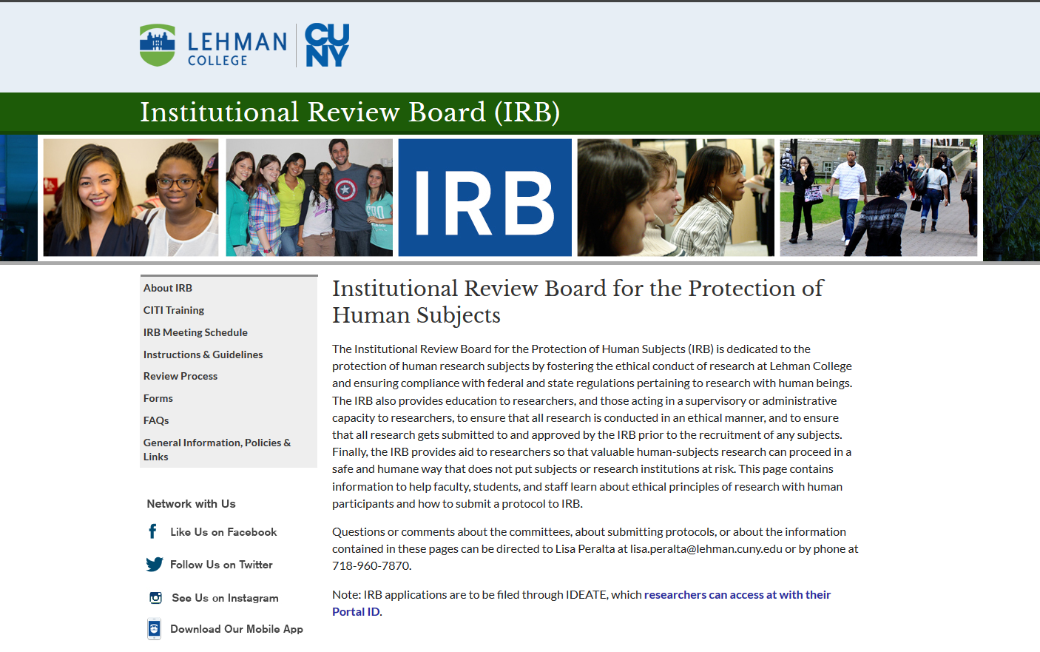

Slide 41
Research Conducted at the NYC Department of Education

Slide 42
NYC DOE IRB
Complete proposals received by the submission deadline will be reviewed during the corresponding IRB meeting. Find calendar here: http://schools.nyc.gov/Accountability/data/DataRequests
All research proposals must be submitted through the NYC Department of Education’s electronic submission platform, IRBManager. To log on to the system go to https://login.irbmanager.com and follow the instructions for creating a password.

Slide 43
Who should submit a proposal to the NYC DOE IRB?
Any person who wishes to conduct research at a school site or gather information on or from students or school staff must obtain written approval from the IRB.
Graduate and undergraduate degree candidates, university faculty, independent researchers, and private and public agencies must all submit proposals before conducting research. This procedure applies even if the researcher is employed by the school system in another capacity (e.g., school administrators and teachers conducting research for graduate studies ).

Slide 44
NYC DOE IRB Continuing Review
Please note that approval to conduct research is in effect for one year only.
If the study is not completed within a year, the researcher must apply for a continuation.
A continuation request should contain a copy of the original IRB approval letter and should detail any changes made to the previously approved research proposal, including changes to the original timeline, research participants yet to be recruited, copies of revised forms, letters and protocols and a summary of findings to date.

Slide 45
NYC DOE Data Requests
If your research does not involve human subjects, and instead exclusively relies on the use of DOE data, you do not need to submit to the IRB. However, you must complete the data request process.
The data request process begins when you submit a brief scope of work (4 page maximum) and a list of your data needs to RPSGresearch@schools.nyc.gov.

Slide 46
NYC DOE Data Requests
The scope of work must include:
The organization conducting the evaluation or the institution the research is affiliated with
A mailing address for the organization or researcher
A statement of the research objectives and the purpose of the study
The research hypotheses and methodology
A timeline that describes key research activities and an estimated completion time
A brief statement of the risks and benefits of the research
A description of how the data will be used and the intended audience(s) for the findings

Slide 47
NYC DOE Data Requests
The scope of work must include:
A list of specific data needs, which must include the following:
School Years needed
Grade levels
The population of data requested (an entire school, district, sample taken for a research project, etc.)
Justification of how each requested data element is connected to the research objectives
A detailed description of the data security plan to ensure protection of student information including but not limited to data encryption, security of the transmission process, and provisions to prevent unauthorized access.
An explicit timeline and description of how the data will be destroyed.

Slide 48
NYC DOE Data Requests
PLEASE NOTE: If you are requesting identifiable student data (including name and student ID) or a combination of variables that could make the data identifiable (including a combination of values such as ethnicity, gender, and name of the school) as an external research, you must have parental consent. Data requests should include a final version of the consent form, an example of which is available here, for approval. Data requesters will also be required to submit electronic copies of all complete consent forms.

Slide 49
ConTACT InFORMATION
Office of Responsible Research Practices
Lisa Peralta
X7870
Shuster 306
lisa.peralta@lehman.cuny.edu

