Slide 1




New Hire Process
A start to finish guide for Hiring Managers
REV: 4/2022

Slide 2

Initial Contact
What to provide to your new employee

Slide 3


New Hire Packets
Lehman Onboarding
Part – Time Classified Civil Service (College Assistant, Student Aide, IT Hourly, Art Model, Disability Accommodations Specialist, etc.)
Part – Time Instructional Staff (Adjunct, Non-Teaching Adjunct, Adjunct College Lab Technician, and Continuing Education Teacher)
Specific packets for specific titles

Slide 4

New Hire Packets – Cont.
Part – Time Classified Civil Service
CUNY Employment Application – Part One
CUNY Employment Application – Part Two
CUNY Employment Application – Part Three
CUNY Employment Application – Part Four
Procedures for Candidate Finger Printing
Personal Data Form
Emergency Evacuation Assistance
Voluntary Self-Identification for Employees
Veteran Status
Voluntary Self-Identification of Disability
Form I-9*
W-4
IT-2104
NYS Direct Deposit Form*
Orientation for IT Security
Oath Upon Appointment
External Employment of Classified Staff
CUNY Policy Checklist
Authorization to Release Reference Information
* Requires additional documentation

Slide 5
New Hire Packets – Cont.
Part-Time Instructional Staff
CUNY Employment Application – Part One
CUNY Employment Application – Part Two
CUNY Employment Application – Part Three
CUNY Employment Application – Part Four
Personal Data Form
Emergency Evacuation Assistance
Voluntary Self-Identification for Employees
Veteran Status
Voluntary Self-Identification of Disability
Form I-9*
W-4
IT-2104
NYS Direct Deposit Form*
Orientation for IT Security
Oath Upon Appointment
CUNY Policy Checklist
Authorization to Release Reference Information
Adjunct Fact Sheet
Information on Union Membership in PSC-CUNY
* Requires additional documentation

Slide 6
Additional Items
New Hire Template
Intended Start Date
Proof of Degree (Adjuncts & NTAs)
Official (Adjunct and NTAs)/Unofficial (CAs & SAs) Transcripts
Fingerprint Receipt
Other required items and information

Slide 7
Department
The role of the Department

Slide 8
Department Role
Initial point of contact
Identify new hire and give information to the Hiring Manager
Send hiring packet to New Hire using provided template
Informing the Hiring Manager of current or former CUNY or Lehman work

Slide 9
Hiring Manager
The role of the Hiring Manager

Slide 10
Hiring Manager Role
Hiring Manager checks to see if there is any connection to CUNY or Lehman College (past or present)
Submit Dropbox link to department to collect hiring packet
For Adjuncts – checks workload limitations
Look over paperwork
All forms are filled out
All forms are signed
Additional Documentation is included
Populate Spreadsheet to keep track of new hire progress and information
Notify the Department to inform them that the paperwork looks good and is now being sent to HR for e-Verification and final processing
Reach out to HR for Dropbox link

Slide 11
Human Resources
The role of Human Resources

Slide 12
Human Resources Role
Send Dropbox link
Look over paperwork and documentation
Process I-9
Send Tax Documents and Direct Deposit Form to Payroll
Notify Hiring Manager
Look over paperwork
All forms are filled out
All forms are signed
Additional Documentation is included
Submit information to E-Verify
If there is a Tentative Non-Confirmation (TNC) we notify employee
Request intended start date
Enters New Hire personal information into CUNYfirst to generate an EMPLID (new to CUNY only)
If the New Hire requires fingerprinting, the start date will be provided by HR
If the employee already has an EMPLID, the employee should check in CUNYfirst to verify that the information is accurate and up to date.

Slide 13
New Hire Workflow
Step 1
to
Step 11

Slide 14
New Hire Workflow
Step 1
to
Step 11
Department identifies New Hire and gives information to the Hiring Manager
1
Hiring Manager checks if there is any connection to CUNY or Lehman and Workload Information (Adjunct only)
2
Hiring Manager sends Dropbox link to the Department to collect the paperwork and additional documentation
3
Department uploads paperwork and additional documentation using the provided Dropbox link
4
Hiring Manager looks over paperwork and contacts the Department if anything is missing or needs correcting
5
Hiring Manager populates the tracker spreadsheet
5a
Hiring Manager notifies the Department that all the paperwork is complete and will be sent to HR
6
HR Sends Dropbox link to the Hiring Manager to collect additional paperwork and documentation
7
HR looks over paperwork and contacts the Department if anything is missing or needs correcting. eVerify is done
9
Hiring Manager uploads paperwork and additional documentation using the provided Dropbox link
8
HR enters New Hire personal information into CUNYfirst to generate an EMPLID (new to CUNY only)
9a
HR forwards tax documents and direct deposit form to Payroll
10
HR contacts Hiring Manager that everything is complete
11

Slide 15
Additional Information
How to “Print to PDF”
How to merge all documents
File name structure

Slide 16

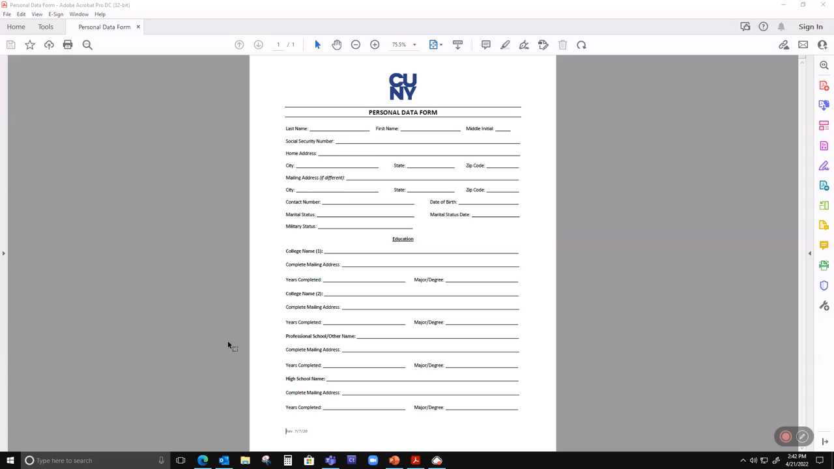
Print to PDF

Slide 17

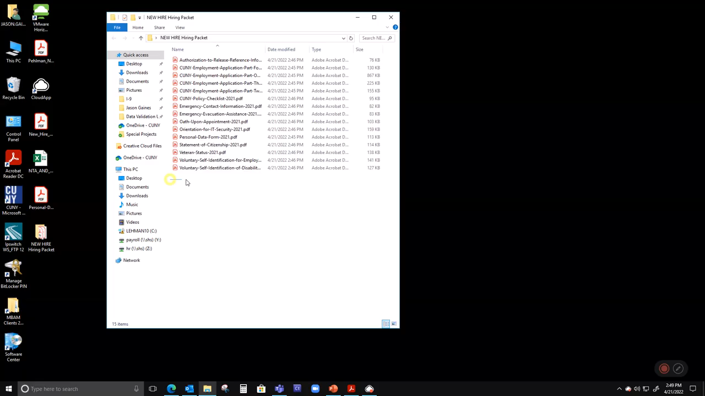
Merge All Documents

Slide 18

File Name Structure
Hiring Packet: Lname_Fname_MI_hp.pdf
I-9: Lname_Fname_MI_i9.pdf
Lname_Fname_MI_i9docs.pdf
Tax Forms: Lname_Fname_MI_tax.pdf
Direct Deposit Form: Lname_Fname_MI_dd.pdf

Slide 19
Post-Onboarding
What’s next?

Slide 20

Submit the ePAF
Using the ePAF System you can now submit your “Initial Appointment” ePAF

Slide 21

New Hire Access
Email
eTime
CUNYfirst
Blackboard
Microsoft Teams
Zoom Access

Slide 22
Part-Time Instructional Staff Contact Template
Part-Time Classified Civil Service Contact Template
New Hire Tracker
New Hire Form
Payroll Schedules
THANK YOU
Contact Us
Jason Gaines
Roberto Hernandez
Miriam Malave
Julissa Torres

