Slide 1

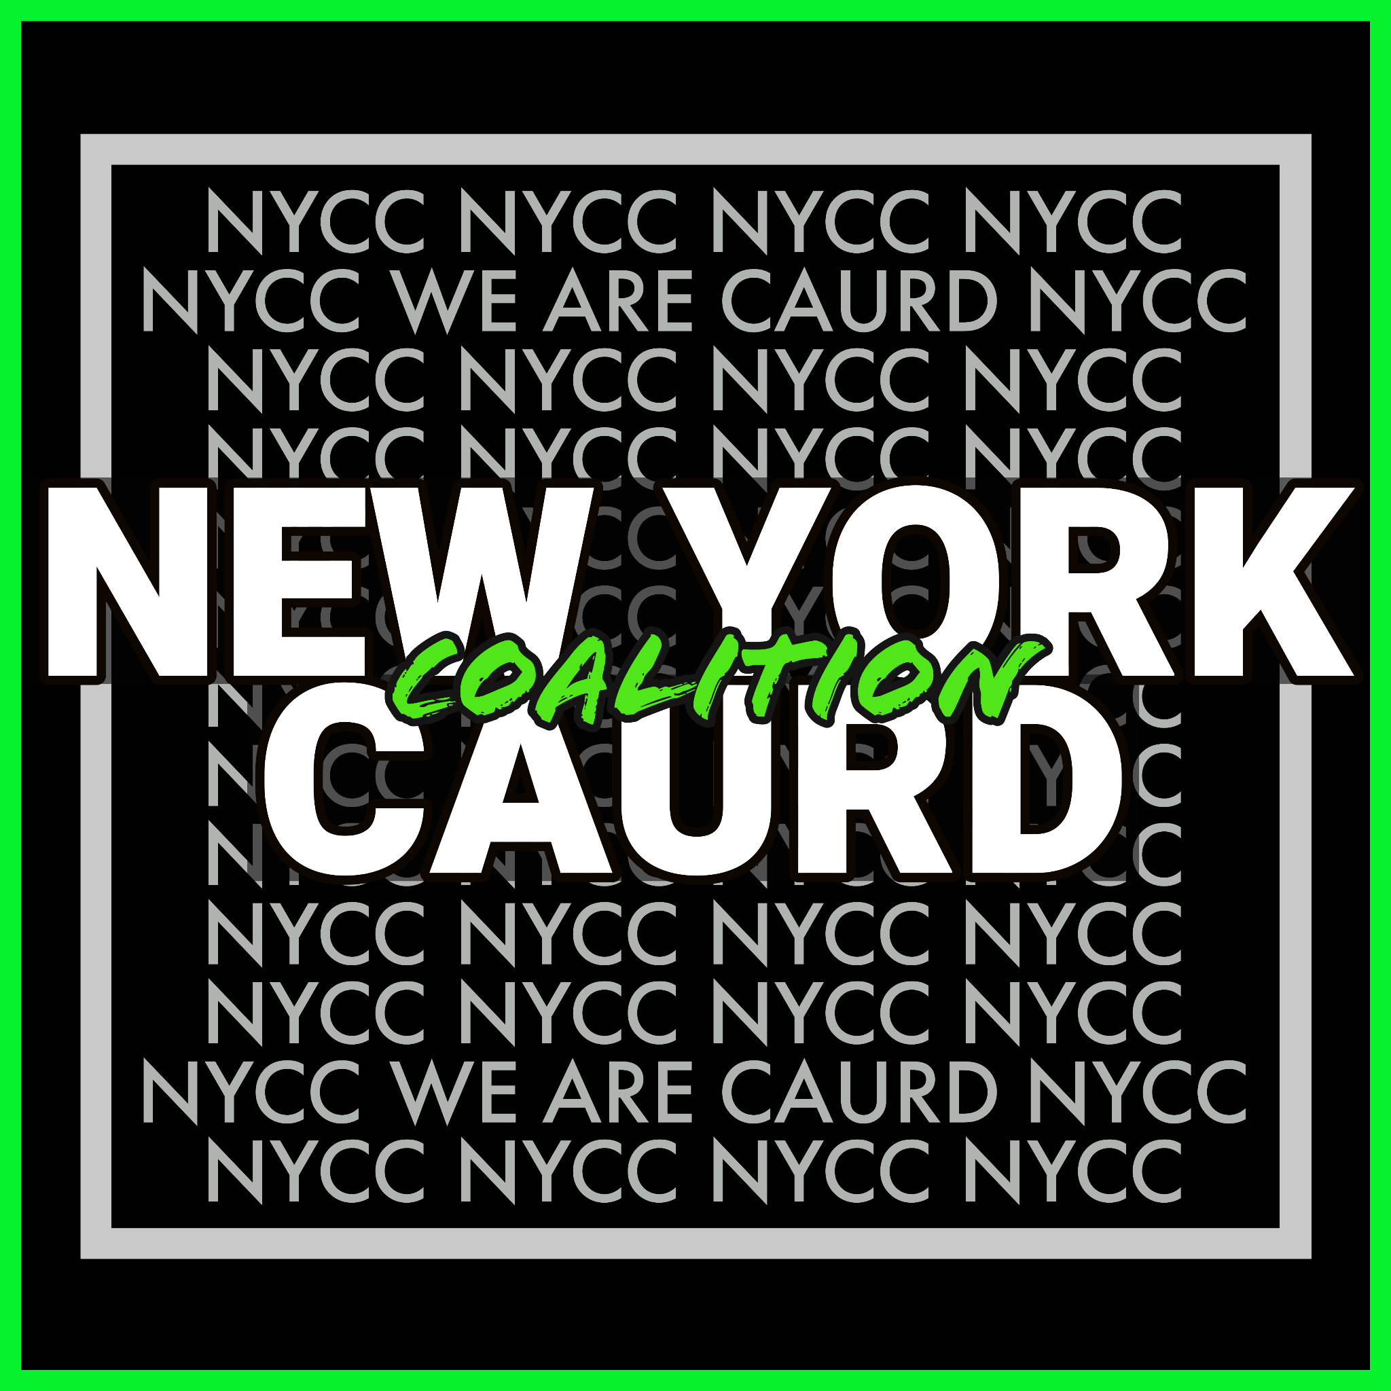
Basic Steps to Start a Cannabis Business in New York State
By
The New York CAURD Coalition
`

Slide 2
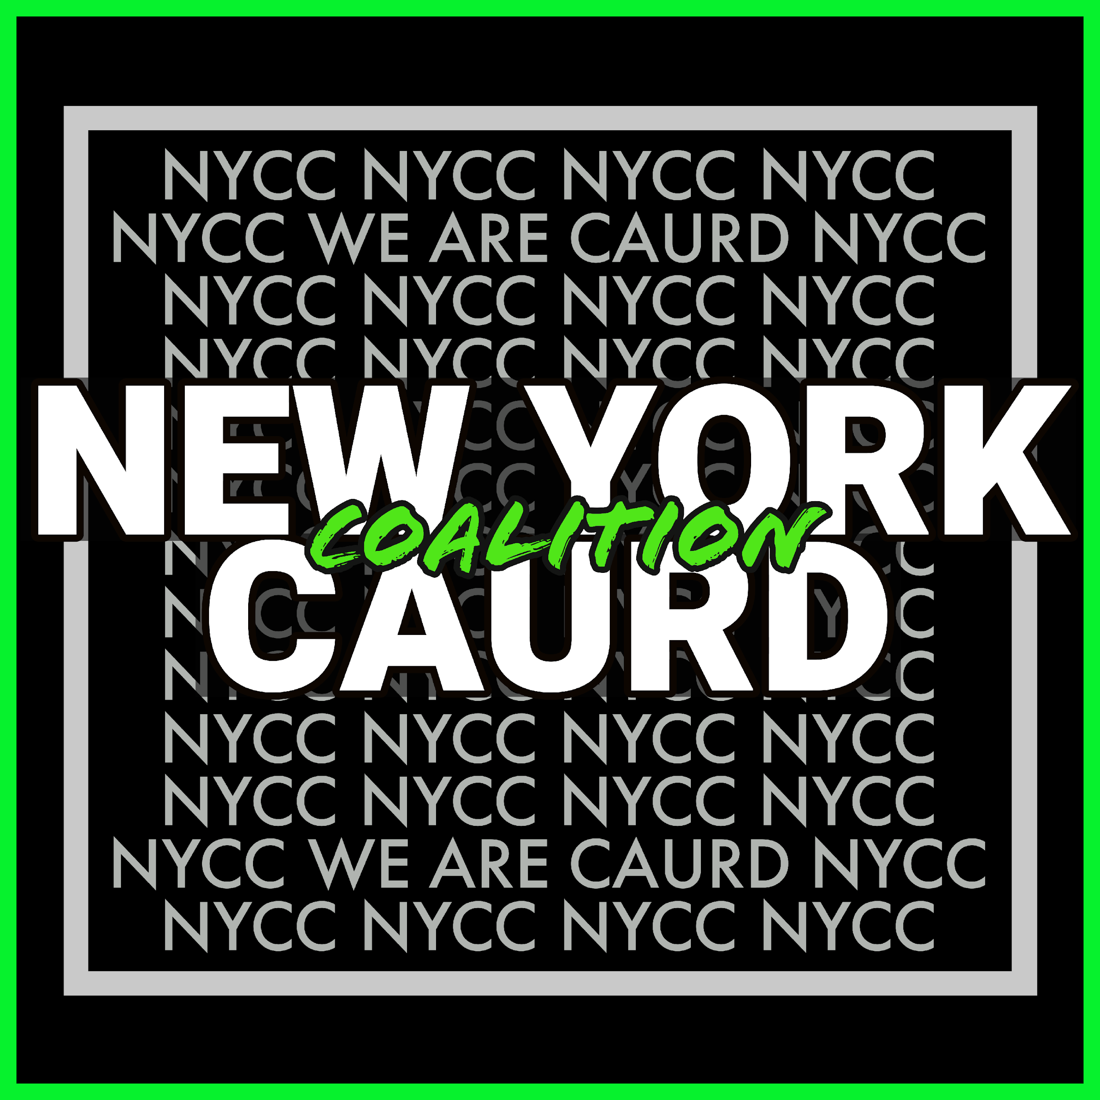
Business Name
Create a Business Name
  Brainstorm potential names for your cannabis business that align with your brand identity and target market. Consider factors like uniqueness, memorability, and relevance to the industry. Ensure that the name is compliant with any specific naming restrictions or requirements in your jurisdiction.
Check Name Availability
  Conduct a thorough search to ensure the business name you've chosen is not already in use by another cannabis company in New York State. Check the New York State Division of Corporations website or consult with a lawyer to perform a comprehensive name availability search.
  Check name availability use https://apps.dos.ny.gov/publicInquiry/
  or use a paid service like: https://www.legalzoom.com/ or https://www.incfile.com/
Design a Logo and Choose Color Schemes
  Work with a graphic designer or branding agency to create a professional logo that reflects your brand identity and resonates with your target audience. Choose color schemes that evoke the desired emotions and align with your brand's aesthetics.
  For help with logos and colors. Try using fiverr.com | peopleperhour.com | odesk.com | freelancers.net

Slide 3

Obtain an Federal Employer Identification Number
Obtain an FEIN (Federal Employer Identification Number):
Step
01
Visit the Internal Revenue Service (IRS) website or call their toll-free number to apply for an FEIN.
Step
02
Fill out Form SS-4 (Application for Employer Identification Number) online or by mail.
Step
03
Once approved, you will receive an FEIN that will be used for tax purposes.
Website for FEIN https://www.irs.gov/
Website for SS-4 https://www.irs.gov/forms-pubs/about-form-ss-4
Toll free number is (800) 829-4933

Slide 4

Select a Legal Structure
Determine the legal structure that best suits your cannabis business, such as a sole proprietorship, partnership, limited liability company (LLC), or corporation.
1
Consult with a lawyer or business advisor to understand the implications of each structure and choose the most appropriate one for your specific needs.
2
You can use a paid service like one of these to purchase your legal structure
https://www.legalzoom.com/ or https://www.incfile.com/

Slide 5




Set Up Online Presence
Set Up Social Media Accounts:
Establish accounts on popular social media platforms like Facebook, Instagram, Twitter, or LinkedIn.
Optimize your profiles with accurate business information, engaging visuals, and relevant content.
Develop a social media strategy to build brand awareness, engage with your audience, and promote your products or services.
Obtain a Domain Name for Your Website:
Choose a domain name that is closely aligned with your business name or brand.
Register the domain name through a reputable domain registrar or web hosting service.
Consider working with a web developer or using website builder tools to create a professional website that showcases your cannabis business.
Try to use the same name for all social accounts.
Don’t use your personal that you already have running

Slide 6

Assemble a Team
Identify the roles and skills required for your cannabis business, such as cultivation experts, lab technicians, marketing professionals, or administrative staff.
"Surround yourself with people smarter than you are"
Recruit and hire team members who align with your business values and possess the necessary expertise.
Provide appropriate training and ongoing development opportunities for your team members.
Select one person to stay updated on regs & all things cannabis

Slide 7



Decide on Location and Type of Cannabis Business
  Determine where you want to operate your cannabis business in New York State.
Realtors/Brokers solely assist in securing locations that guarantee them a commission. Regardless of the exceptional suitability of a location for your business, they will not provide assistance if there is no commission involved.
  Consider factors such as zoning regulations, proximity to your target market, accessibility, and local business environment.
  Determine the type of cannabis business you want to establish, whether it's cultivation, manufacturing, distribution, retail, or a combination thereof.
Notify the local government or municipality to avoid potential difficulties. Failure to do so may complicate your search for a location, leading to a bad learning experience

Slide 8
Develop a Business Plan
  Create a comprehensive business plan that outlines your vision, mission, goals, target market, product or service offerings, marketing strategies, financial projections, and operational plans.
Vision
Mission
  Include information on the competitive landscape, SWOT analysis, and a clear roadmap for achieving your business objectives.
Target
Market
Goals
Words from Chairwoman Tremaine Wright
“you need a sound business plan”
SWOT
Analysis
Notes:
We need another hexagon adding Community Plan

Slide 9
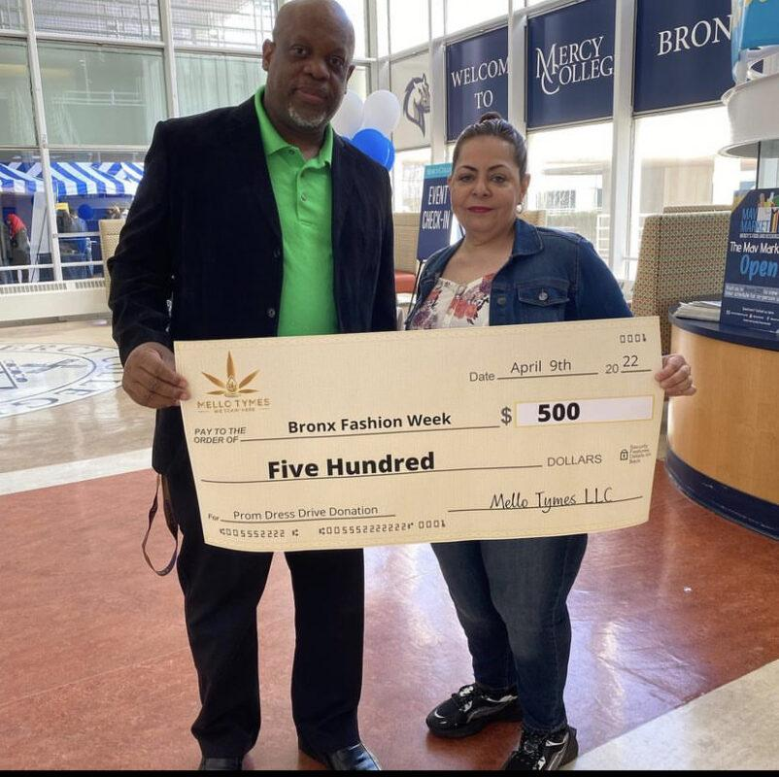
Community Plan
Reintegration and Support Services for Returning Citizens: Develop programs and services aimed at supporting individuals who are returning to their home community after being incarcerated.
Community Outreach and Support: Establish partnerships and programs that support local charities, nonprofits, or community organizations. This may involve organizing fundraisers, donation drives, or volunteer activity
Elderly Outreach and Support Programs: Develop initiatives to provide support and assistance to the elderly population within the community. This can include organizing events or workshops, educational sessions on the potential benefits of cannabis for age-related ailments.
Notes:
Social Equity Programs Charitable Contributions Collaboration with Local Businesses Job Opportunities Sponsorship and Support Educational Programs Volunteer Initiatives

Slide 10

Stay Updated on Regulations and Join Organizations
Stay informed about the latest regulations, licensing requirements, and compliance obligations specific to the cannabis industry in New York State.
  Regularly check official government websites and subscribe to relevant newsletters or industry publications.
Join local and national cannabis industry organizations or associations to network, gain industry insights, and access resources and support.
National Organization for the Reform of Marijuana Laws (NORML)
Women Grow
Minority Cannabis Business Association: MCBA
NYCCIA & HVCIA
Bronx Canna
Some orgs to join
Notes:
Put in OCM website under regularly check official government websites

Slide 11
Understand Resources Required
Conduct a thorough assessment of the resources needed to execute your cannabis business plan. This includes financial resources, licenses and permits, facilities, equipment, personnel, and marketing.
01
Identify potential funding sources, such as personal savings, loans, investors, or grants, to ensure you have the necessary capital.
02
NYS Office of Cannabis Management
Cannabis Hub
NYC Small Business Services
NY CAURD Coalition
Current Licensee
Bronx Canna
NYCCIA & HVCIA
Resources to be considered ..

Slide 12
Apply for a License through Business Express
01
Visit the New York State Business Express website (https://www.businessexpress.ny.gov/) and create an account.
02
Create an account and select the "Start Your Business" option.
03
Follow the prompts to provide the required information about your business, including its name, legal structure, address, and contact details.
04
Specify that you are applying for a cannabis license and complete the application form accordingly.
05
Pay the application fee as required.
06
Submit the completed application through the online portal.

Slide 13
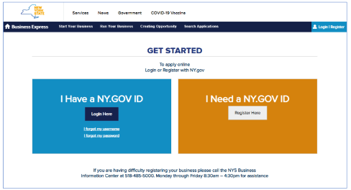
https://www.businessexpress.ny.gov/

Slide 14
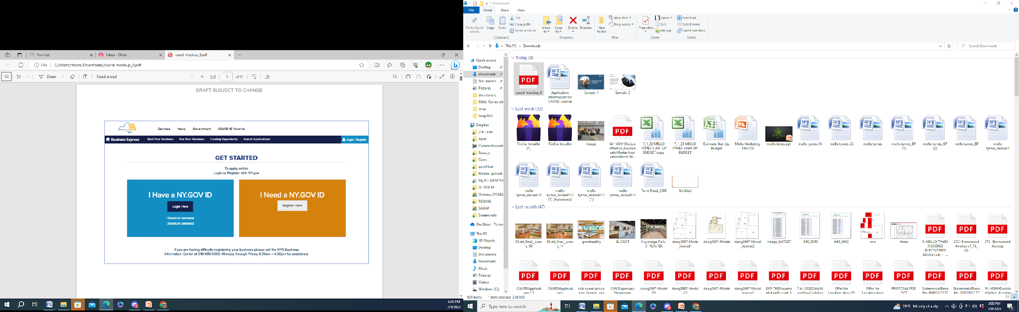
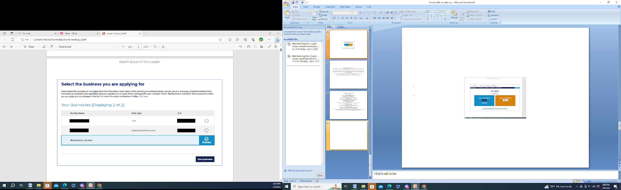
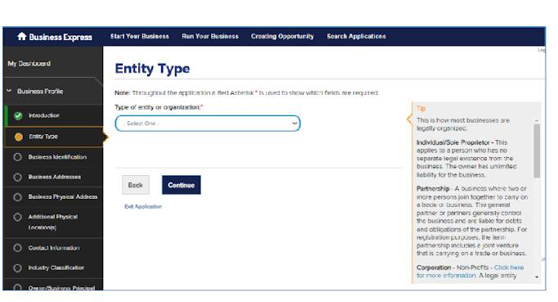
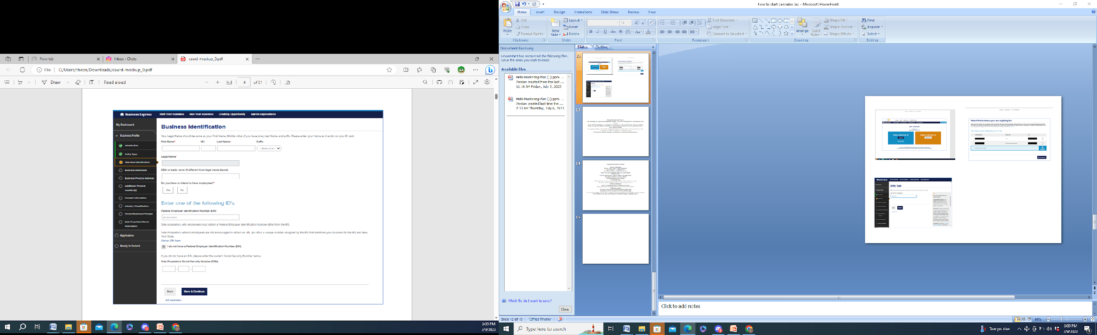
Application for New Business

Slide 15
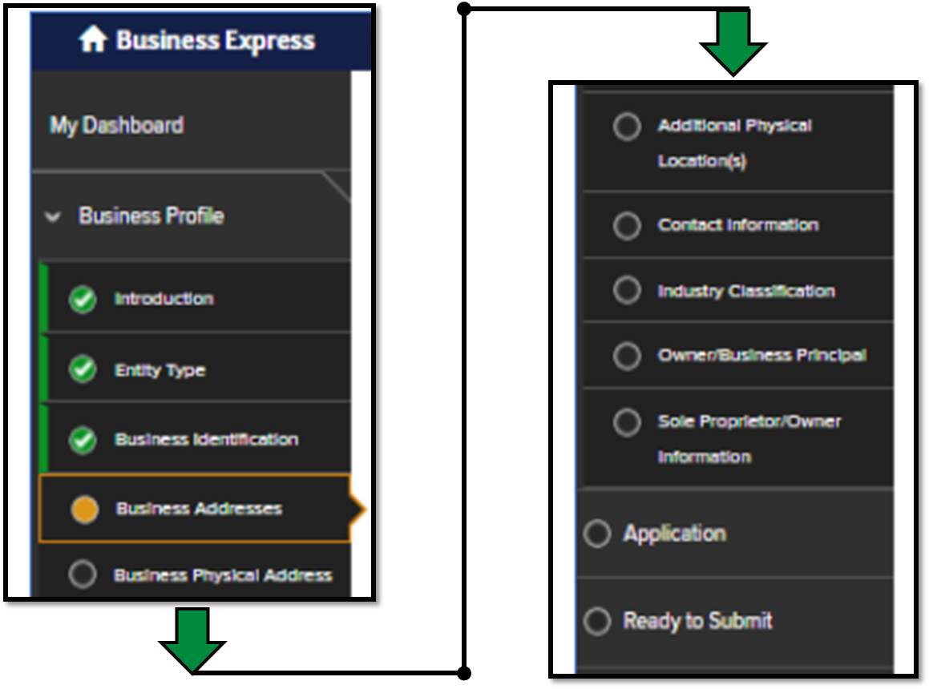
Business Express Menu
This tap is the actual cannabis application

Slide 16
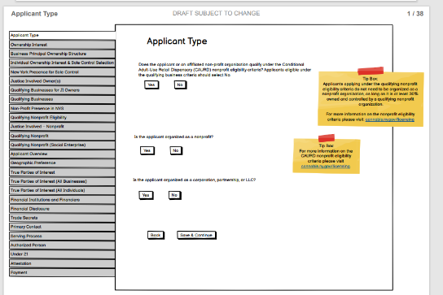
Cannabis Application
Cannabis application menu about 38 tabs

Slide 17


Snapshot of application dashboard
Business Information
Business plan
Financial Information
Proof of ownership or lease agreement
Each Team Member compete info
Site plan and floor plan
Community Plan
Security plan
Security Measures
Standard operating procedures (SOPs)
Funding info
Financial documents
Legal structure
Background checks
Online Presences
Community engagement plan
Main contact info
Tax and financial info
Completed application form
Insurance coverage
Spouse Information

Slide 18
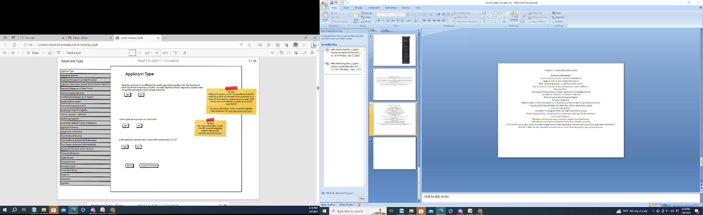
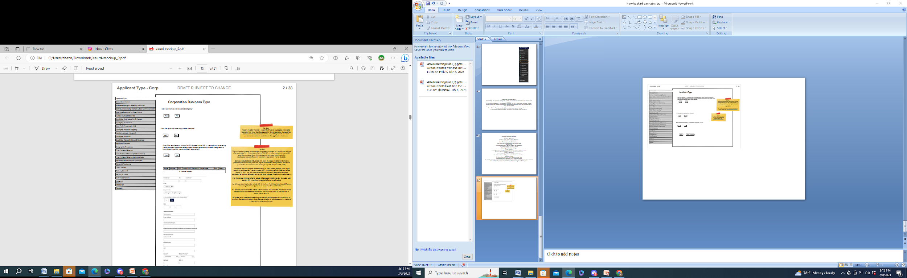
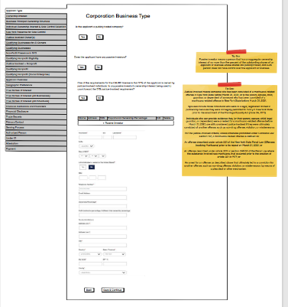
Cannabis Application
NY is the first state to make the application process affordable and online.
Better than paying a lawyer
$100K - $200k.

Slide 19
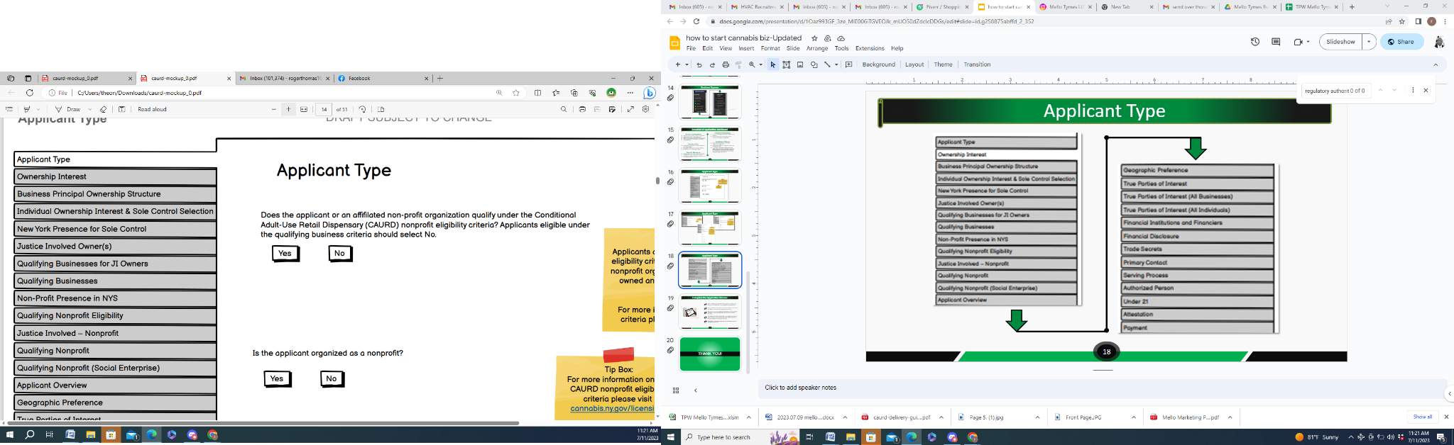
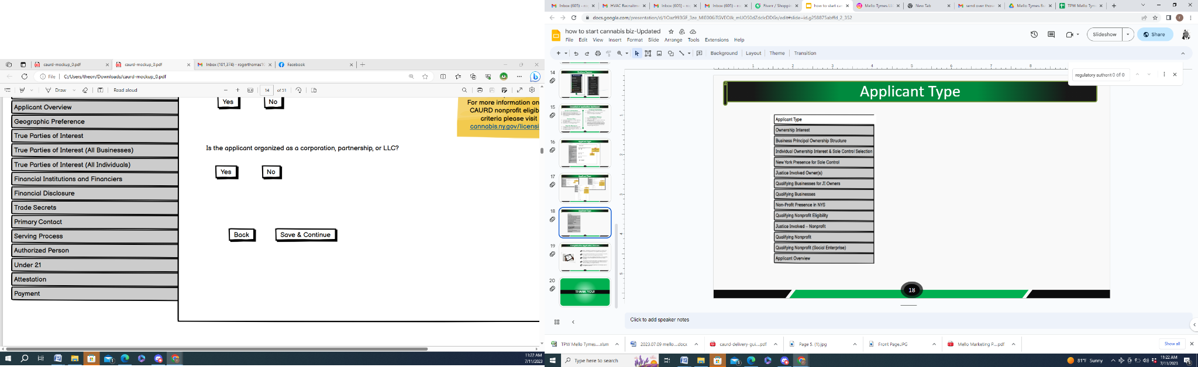
Cannabis Application Menu
Some tabs requires 3 or 4 documents.
You will need to upload about 60 separated documents in all 30 tabs

Slide 20


Complete the Application Process
  After submitting the application, the Office of Cannabis Management (OCM) will review it for completeness and compliance with regulations.
  If any additional information or documentation is required, you will be notified by the OCM.
  Provide any requested additional information or documentation promptly to ensure the application process moves forward smoothly.
  The OCM will evaluate your application based on various factors, such as your business plan, security measures, financial stability, and compliance history.
  Be prepared for potential inspections and interviews as part of the application process.
The OCM will evaluate your application based on various factors that you are not aware of and wont share with you..

Slide 21

Managing a Cannabis Business
&
Ancillary Cannabis Businesses

Slide 22
Managing a Cannabis Business
The cannabis industry has boomed with global legalization, offering diverse job opportunities. Costs vary by location, role, and experience. Here's a look at common cannabis jobs and their potential expenses:
Cannabis Dispensary:
Extraction and Production:
Budtender: Assisting customers, ensuring compliance with regulations.
      Salary: Hourly, $Minimum wage to $20+ per hour.
Dispensary Manager: Overseeing daily operations.
  Salary: $40,000 to $80,000+ per year.
Extraction Technician: Producing concentrates and oils.
      Salary: $40,000 to $70,000+ per year.
Lab Technician: Ensuring product quality and safety.
  Salary: $30,000 to $60,000+ per year.
Edibles Chef: Creating infused products.
  Salary: $40,000 to $80,000+ per year.
Cannabis Cultivation:
Sales and Marketing:
Grower: Cultivating and maintaining plants.
      Salary: Master Growers $50,000 to $100,000+, Cultivation Technicians $30,000 to $60,000 per year.
Sales and Marketing: Promoting products and developing brand strategies.
      Salary: Ranges from $40,000 to six-figures +
      per year.

Slide 23
Managing a Cannabis Business
Compliance and Finance:
Other Roles:
Compliance Officer: Ensuring regulatory adherence.
      Salary: $40,000 to $80,000+ per year.
Finance and Accounting: Handling financial aspects.
  Salary: Ranges from $40,000 to six-figures + per year.
Delivery Driver: Safely transporting products.
      Salary: Hourly, location-dependent.
Quality Control Specialist: Ensuring product quality.
  Salary: $40,000 to $70,000+ per year.
HR and Training Manager: Handling HR functions.
  Salary: $50,000 to $90,000+ per year.
Inventory Specialist: Managing inventory control.
  Salary: $35,000 to $60,000+ per year.
Compliance Manager: Overseeing regulatory compliance.
  Salary: $50,000 to $100,000+ per year.

Slide 24
Ancillary Cannabis Businesses
Ancillary cannabis businesses enhance industry efficiency, safety, and compliance. Salaries vary based on roles, experience, and niche.
Cannabis Testing Laboratories:
Cannabis Event and Trade Show Organizers:
  Conduct safety, potency, and compliance testing.
Salary: Lab techs and scientists earn $40,000 to $80,000+ per year.
  Plan cannabis-related events.
Salary: Event coordinators earn $40,000 to $80,000+ per year.
Transportation and Logistics Companies:
Cannabis Packaging Equipment Manufacturers:
  Securely transport cannabis products.
Salary: Drivers and logistics personnel earn $30,000 to $60,000+ per year.
  Supply packaging machinery.
Salary: Engineers and techs earn competitive salaries

Slide 25
Ancillary Cannabis Businesses
Insurance Providers:
Cannabis Packaging Design Firms:
  Offer tailored cannabis insurance.
Salary: Professionals earn $40,000 to $100,000+ per year
  Design compliant packaging.
Salary: Designers earn competitive salaries
Cannabis Waste Disposal Services:
Packaging and Labeling Companies:
  Dispose of cannabis waste.
Salary: Employees earn $30,000 to $60,000+ per year
  Create compliant packaging and labels.
Salary: Employees earn $40,000 to $80,000+ per year

Slide 26
Ancillary Cannabis Businesses
Security Firms:
Marketing and Advertising Agencies:
  Provide comprehensive security.
Salary: Security personnel earn $30,000 to $60,000+ per year
  Offer specialized marketing services.
Salary: Marketing professionals earn $40,000 to six-figures + per year
Technology Companies:
Legal and Consulting Firms:
  Develop tailored tech solutions.
Salary: Salaries vary, with software developers earning $60,000 to six-figures + per year
  Provide expert advice on cannabis regulations.
Salary: Professionals earn $60,000 to $150,000+ per year

Slide 27
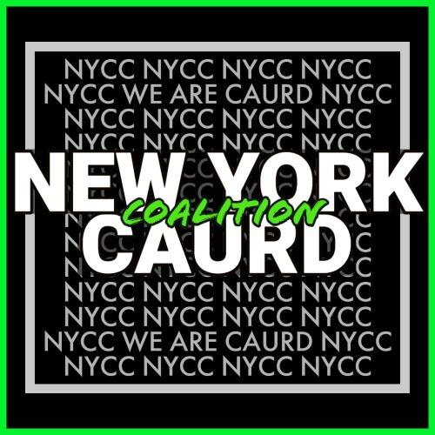
Thank You
www.newyorkcaurdcoalition.org

