Slide 1
TRANSFER ADVISING TECHNOLOGIES
There are a multitude of academic technologies that are available to us as we work with our students. This session focuses on how our technologies actually work together to promote student success. You will receive an overview of available technologies as well as some specific tips and tricks for the most widely used tools.
Learning Outcomes:
Participants will learn about new transfer functions in DegreeWorks and CUNYfirst.
Participants will learn how to leverage available technologies to assist in transfer advising.

Slide 2
AGENDA
Introductions
CUNY Technology through the ages…
Bridge between CUNYfirst and DegreeWorks
Demo of Useful Transfer Tools
Q&A

Slide 3
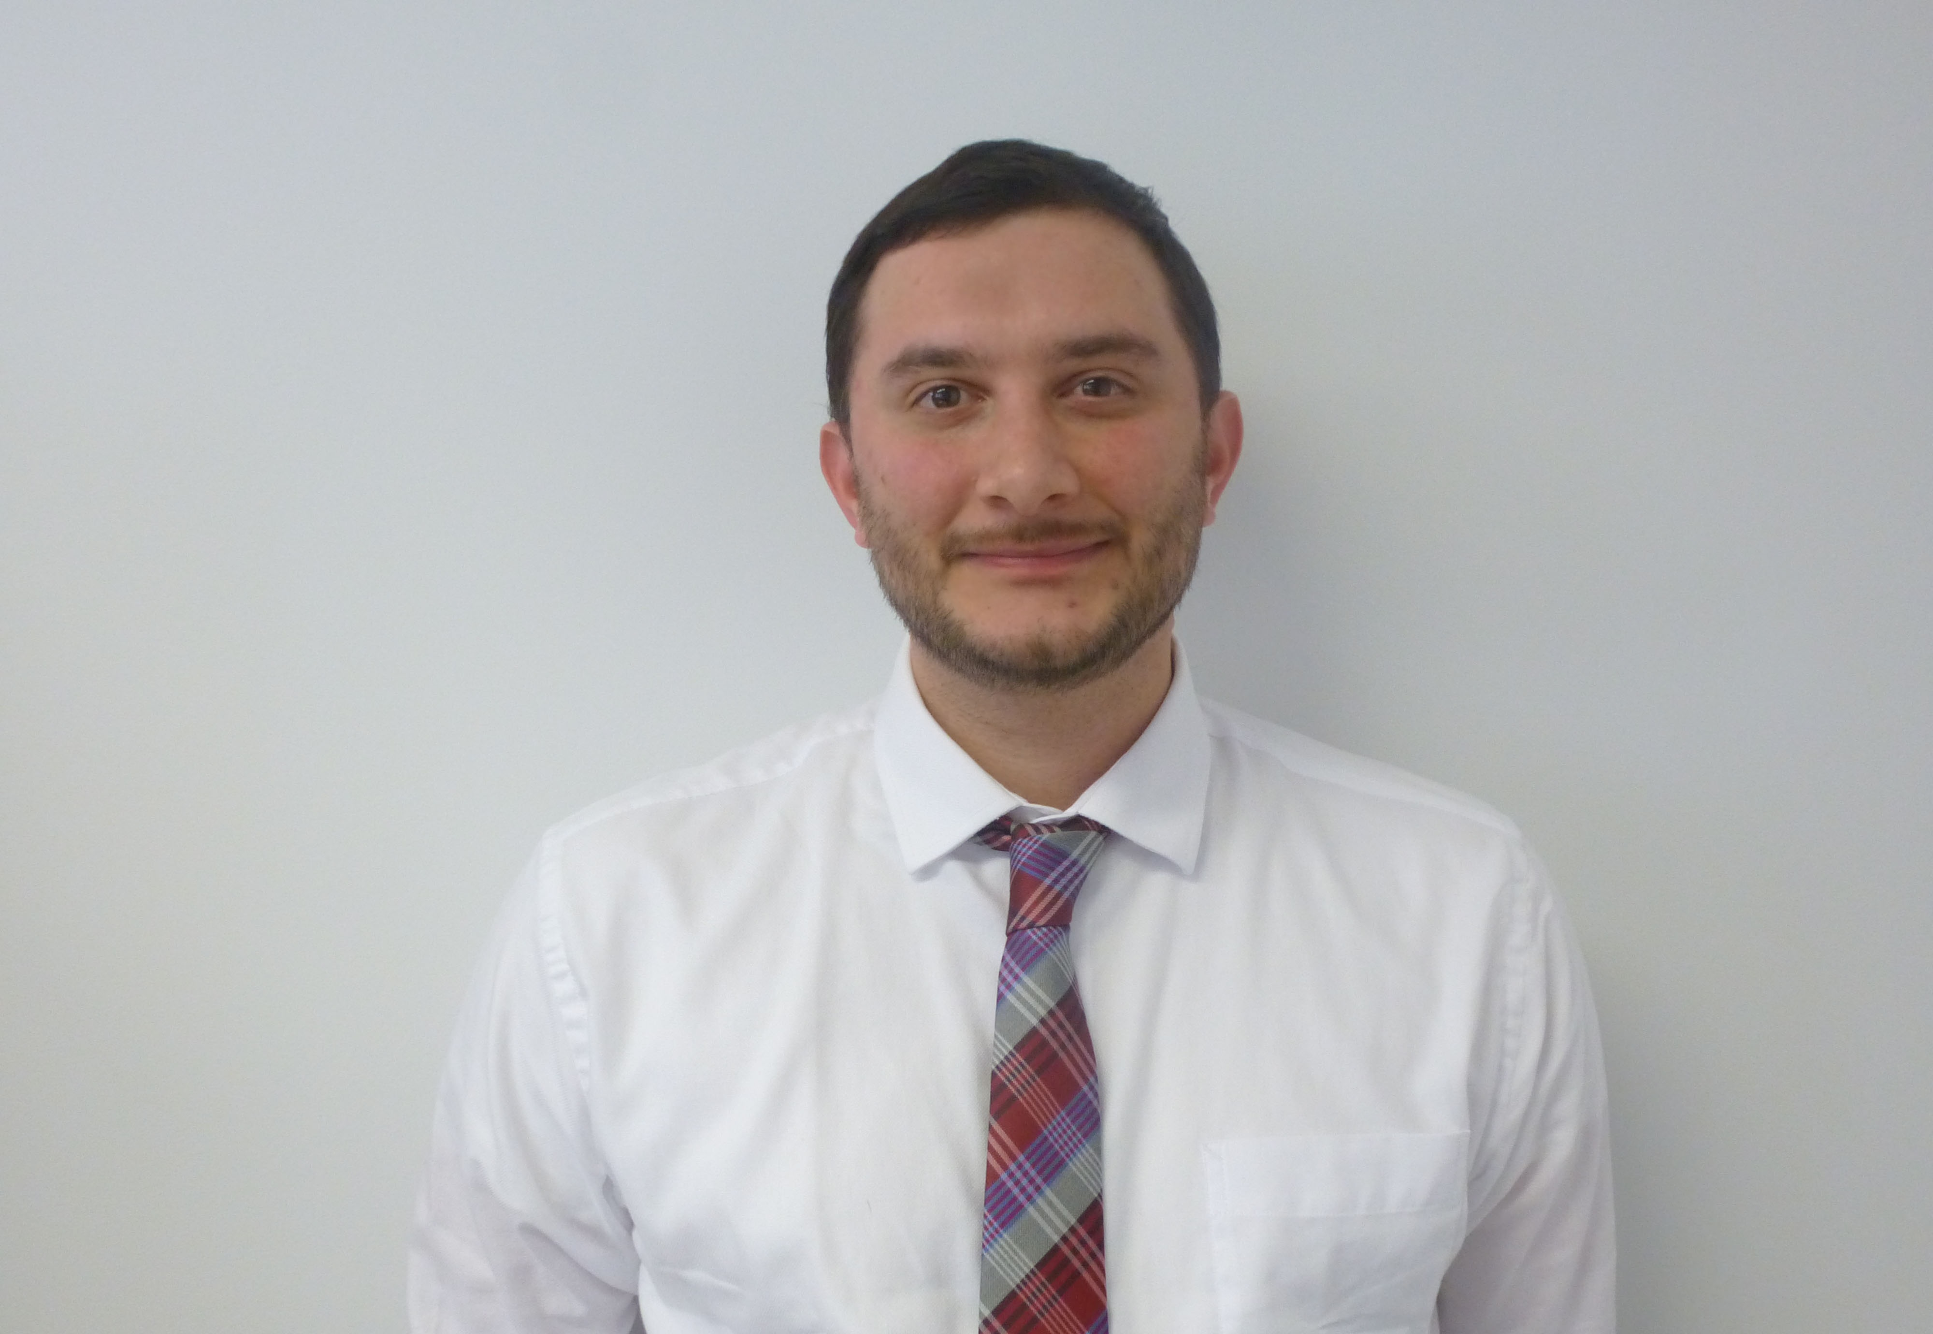
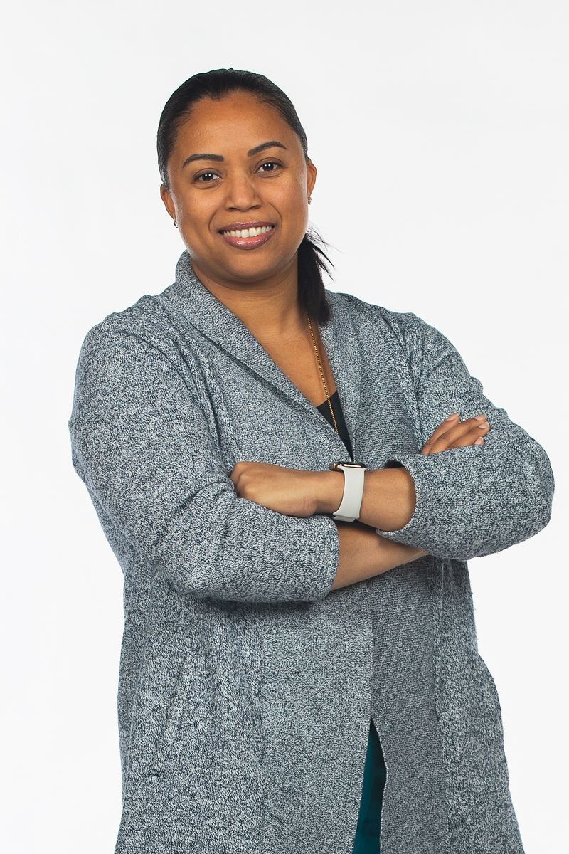
mEET THE TEAM
Diana Babb
Registrar Specialist
Guttman Community College
Chris Buonocore
Director of Student Success Initiatives
Lehman College
Deira Pereyra
Director of IT Application Services
Lehman College

Slide 4
A TRIP THROUGH TIME

Slide 5
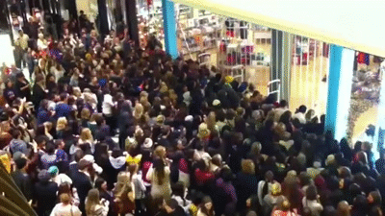
BACK THEN…

Slide 6
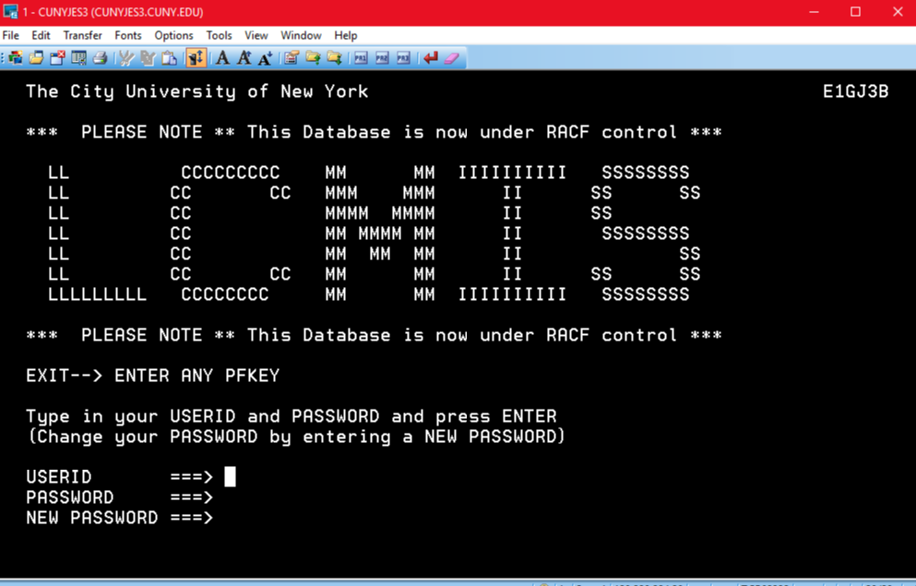
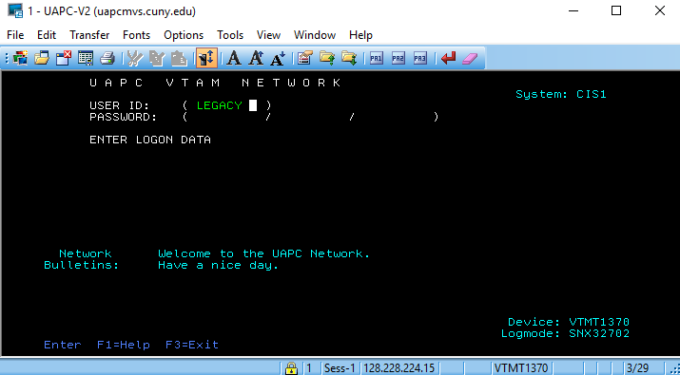
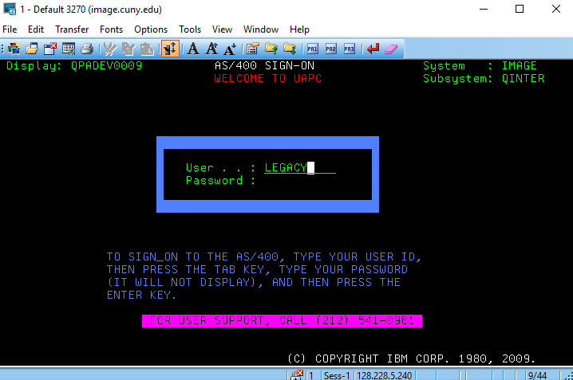
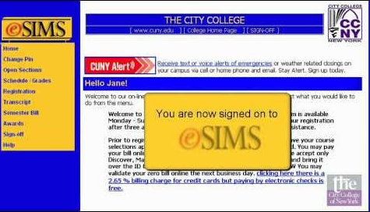
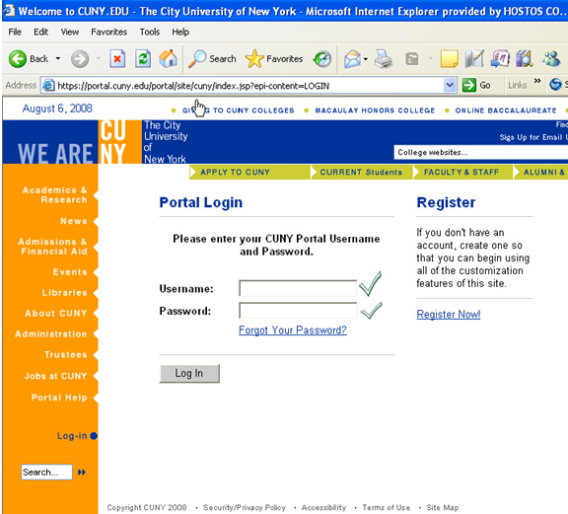
Cuny TECHNOLOGY THROUGH THE AGES

Slide 8
Business Process AUTOMATION
Lessen administrative burden
Automate tasks, not people
Examples:
Personnel Action Form (Hiring)
Course Scheduling
Record Modification Request (eRMR)
Major Declaration
Electronic Transfer Credit Evaluation (eTCE)
Others

Slide 9
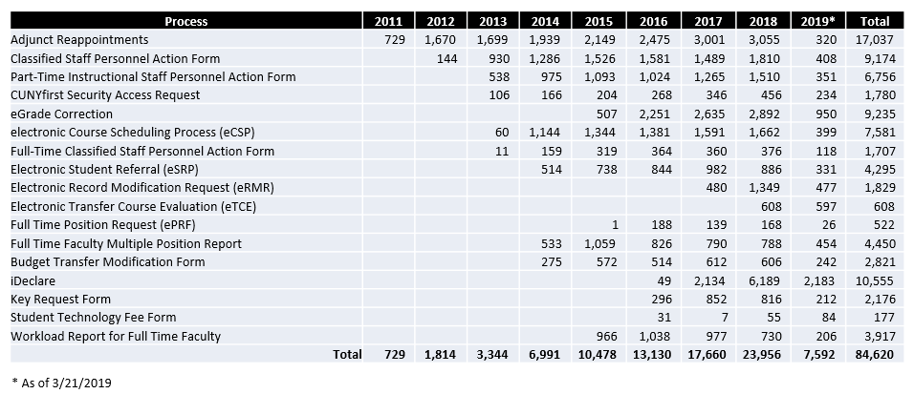
Business Process AUTOMATION
Transactions By Year
Work Faster with Automation…

Slide 10
Artificial Intelligence
AI makes it possible for machines to learn from experience, adjust to new inputs and perform human-like tasks.
Machine Learning
Chatbots
Work Smarter with Artificial Intelligence…

Slide 11
MACHINE LEARNING
An application of Artificial Intelligence (AI) that provides systems the ability to automatically learn and improve from experience without being explicitly programmed.
Machine learning focuses on the development of computer programs that can access data and use it to learn for themselves.

Slide 12
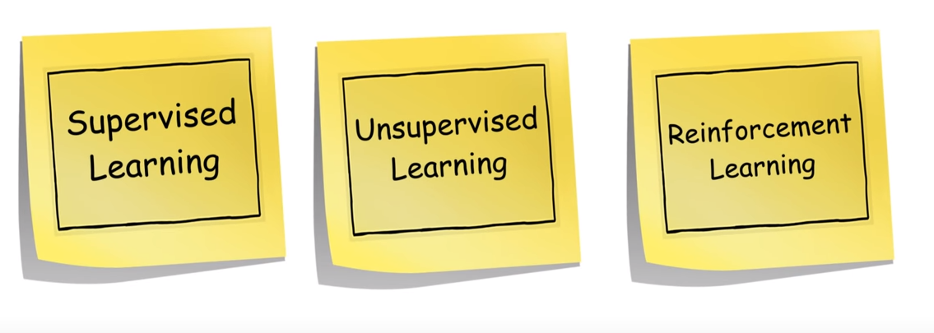
MACHINE LEARNING

Slide 13
Salesforce Einstein
Oracle Business Intelligence

Slide 14
CHATBOTS
AI applications designed to simulate how a human would behave as a conversational partner.
Personalized interaction at scale
Learns from users behaviours
Needs to be trained

Slide 15
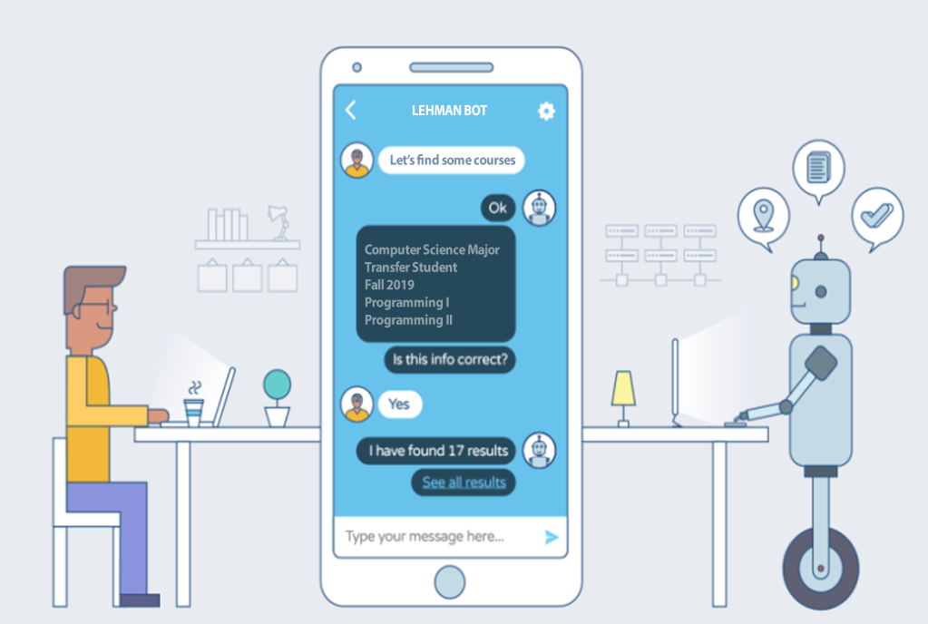
Let The Bot Do Some Work…

Slide 16
Back to 2019

Slide 17
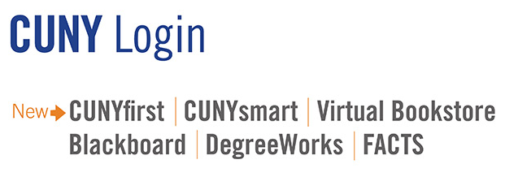
TODAY’S TECHNOLOGY

Slide 18
TODAY’S TECHNOLOGY

Slide 19
INTERCONNECTIVITY, AKA THE BRIDGE

Slide 20
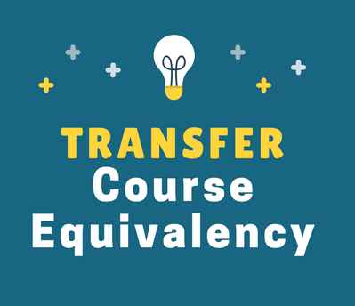
TRANSFER CREDIT RULES
Evaluate My Transfer Credit
Course “Fetch”
Reverse Transfer
ePermit
TWIF

Slide 22
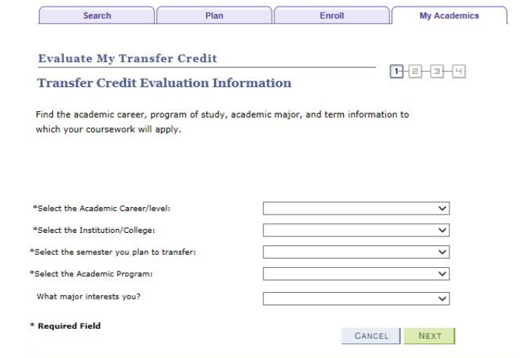
EVALUATE MY TRANSFER CREDIT
Enhanced replacement for TIPPS
Always available in the CUNYfirst Student Center
Displays how a credit will transfer but not how a credit will apply

Slide 23
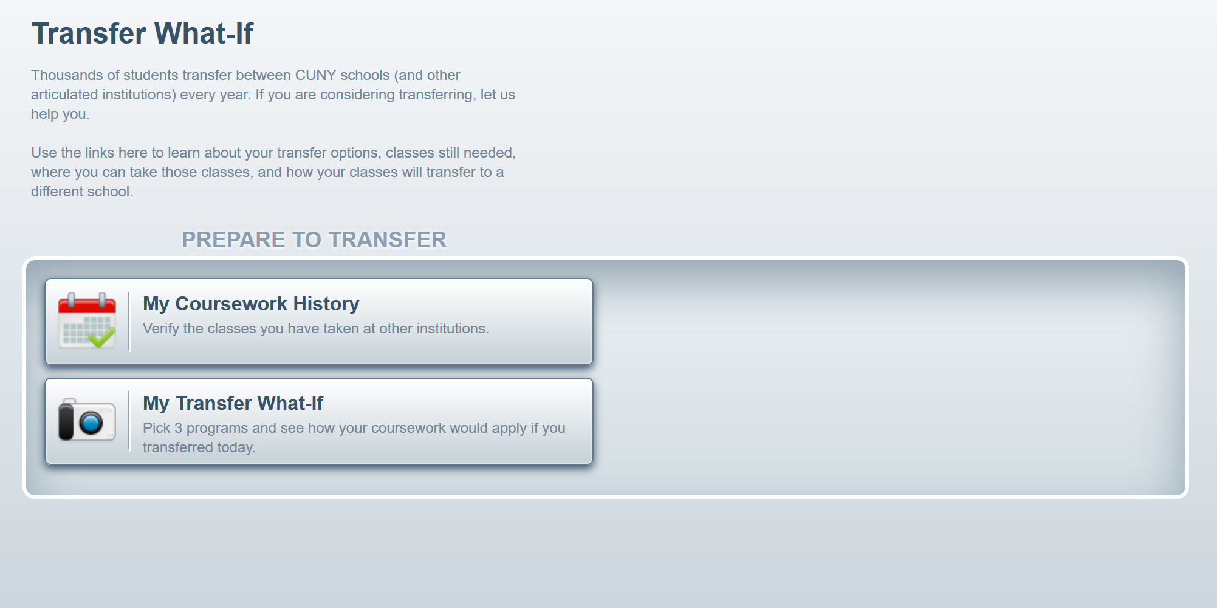
TRANSFER FINDER / TRANSFER WHAT-IF / TWIF
Displays how a credit will transfer AND how a credit will apply
Allows a student and advisor to ask the question “How will my credits apply if I transfer to Lehman and study Accounting”?
Other features:
Considers all CUNY enrollment
Compare up to 3 colleges / programs at a time
Save as PDF for future use and discussion with advisor

Slide 24
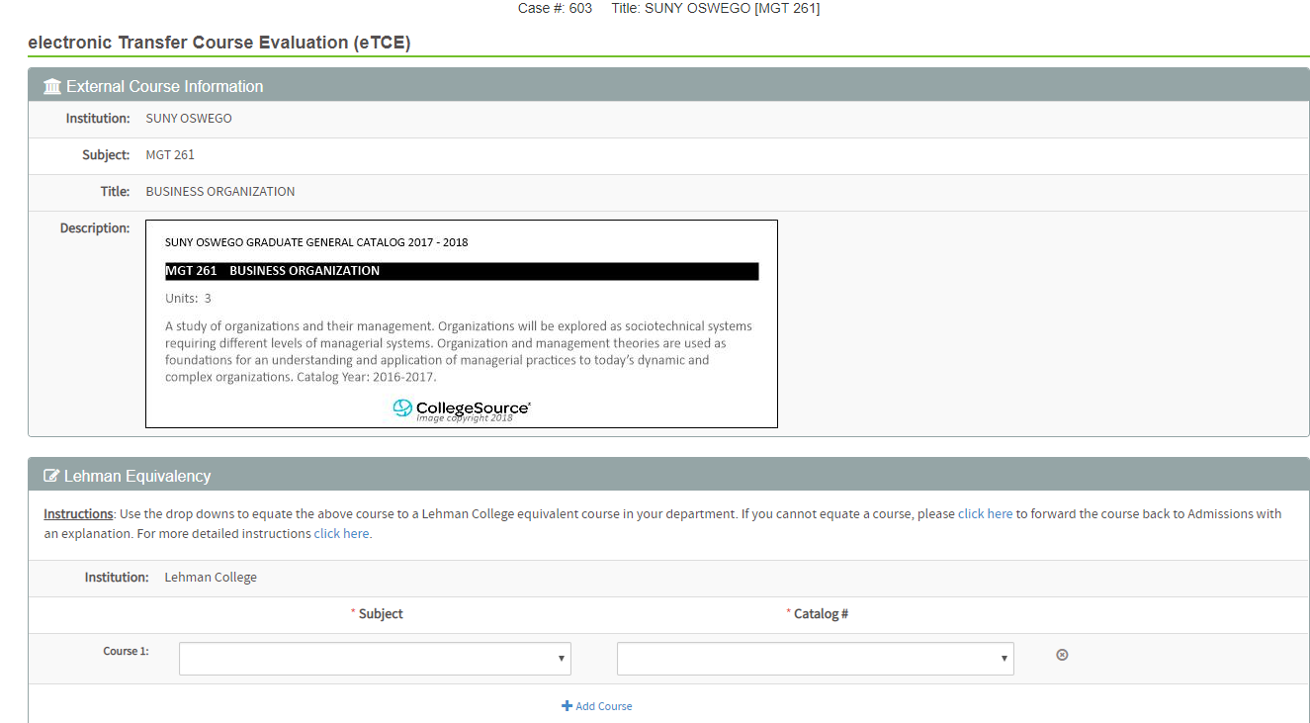
ELECTRONIC TRANSFER CREDIT EVALUATION (eTCE)
Automated process for courses that do not have a transfer credit rule
Reduces the “shuffle”
Courses routed to appropriate department and displays course descriptions

Slide 25
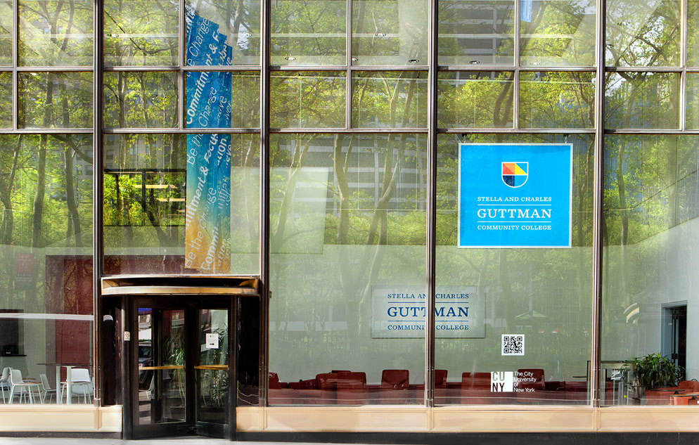
downloads
USEFUL TRANSFER QUERIES & SECURITY ROLES
CUNY STUDENT SUMMARY VIEW TIPS & TRICKS
Control + F searching
Sorting the columns
Pressing the ‘end’ and ‘home’ key
Utilizing ‘New Window’
Keep CUNYfirst and DegreeWorks open side by side, same browser
Queries to find transfer related information
Security roles needed by all advisors

Slide 26
HOMEWORK
What’s missing?
Let us know!
YOUR HOMEWORK
Consider how can you use technology to streamline transfer related processes at your campus.
Confirm that you have the right security roles to view everything that you need access to.
Identify the go-to person on your campus for troubleshooting transfer related issues. If you don’t know who it is… can it be you?
OUR HOMEWORK

Slide 27
Q&a
Diana Babb
Registrar Specialist
Diana.Babb@guttman.cuny.edu
646-313-8074
Christopher Buonocore
Director, Student Success Initiatives
Christopher.Buonocore@lehman.cuny.edu
718-960-8448
Deira Pereyra
Director of IT Application Services
Deira.Pereyra@lehman.cuny.edu
718-960-8694

Slide 28
Thank you

